Slide 1
Regression Fundamentals
UIUC ECON 490: Applied Machine Learning in Economics

Slide 2
Inference Interpretation
Height vs. Weight

Slide 3
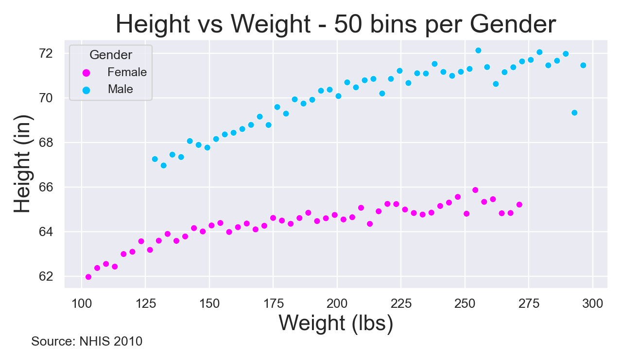
Make Me Taller

Slide 4
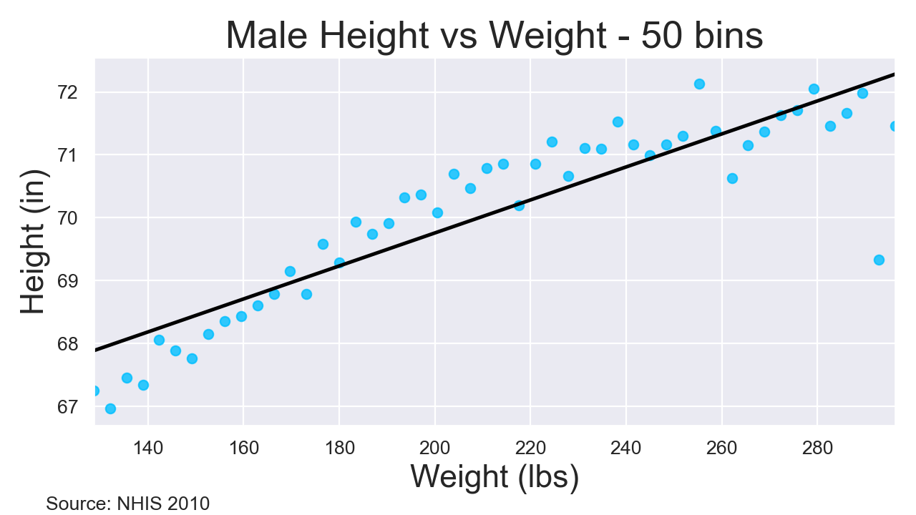
Make Me Taller

Slide 5
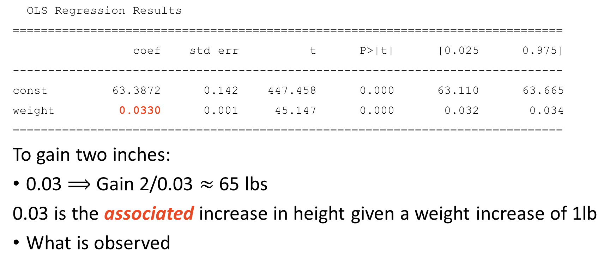
Make Me Taller
OLS Regression Results
==============================================================================
coef std err t P>|t| [0.025 0.975]
------------------------------------------------------------------------------
const 63.3872 0.142 447.458 0.000 63.110 63.665
weight 0.0330 0.001 45.147 0.000 0.032 0.034
==============================================================================
To gain two inches:
0.03 $⟹$ Gain 2/0.03 $≈$ 65 lbs
0.03 is the associated increase in height given a weight increase of 1lb
What is observed

Slide 6
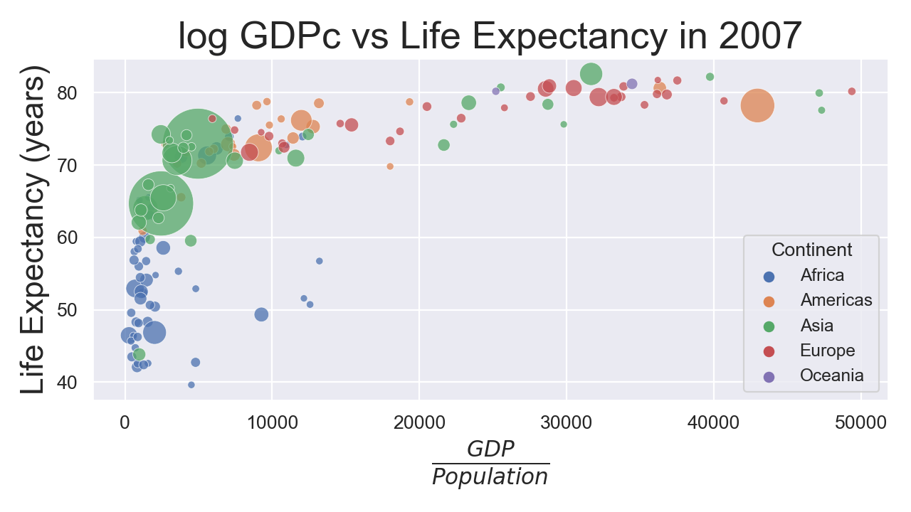
Careful…

Slide 7
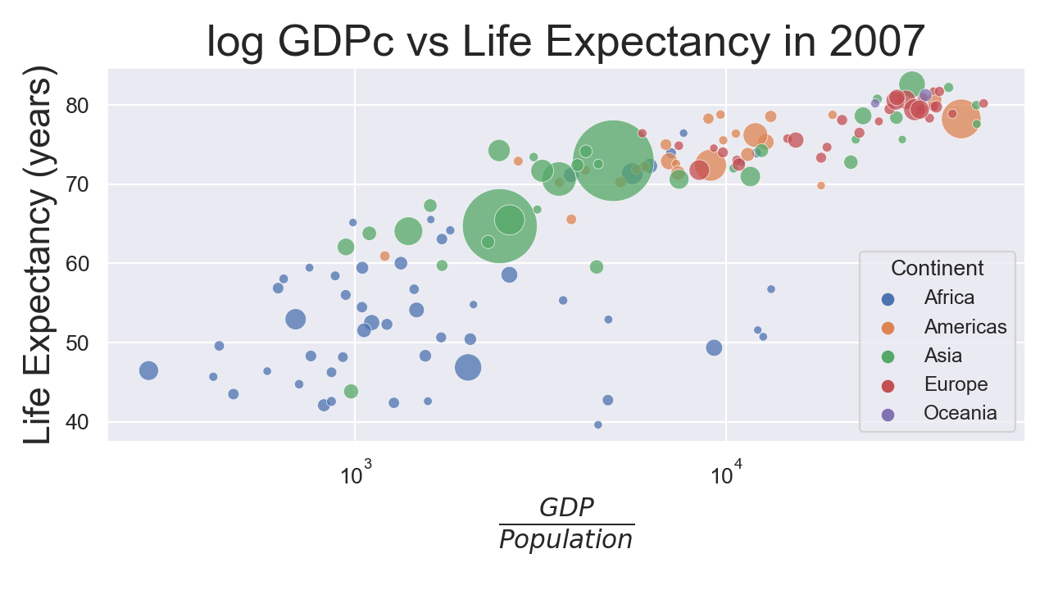
Careful…

Slide 8
Careful…
OLS Regression Results
==============================================================================
Dep. Variable: lifeExp R-squared: 0.654
===============================================================================
coef std err t P>|t| [0.025 0.975]
-------------------------------------------------------------------------------
const 4.9496 3.858 1.283 0.202 -2.677 12.576
l_gdpPercap 7.2028 0.442 16.283 0.000 6.328 8.077
==============================================================================
7.2 is the association between log GDPc and life expectancy
Increasing log GDPc by 1 will not cause life expectancy to increase by 7.2 years
Increasing log GDPc by 1 will not increase life expectancy by 7.2 years

Slide 9
Careful…
7.2 is the association between log GDPc and life expectancy
Increasing log GDPc by 1 will not cause life expectancy to increase by 7.2 years
Increasing log GDPc by 1 will not increase life expectancy by 7.2 years
Is the causal effect positive?
Probably
Is it higher or lower than 7.2?
I don’t know
Increasing GDPc increases pollution (lowering life expectancy)
Increasing GDPc increases health care technology (increasing life expectancy)
See ECON 474

Slide 10
Careful…

Slide 11
Estimation
Ordinary Least Squares

Slide 12
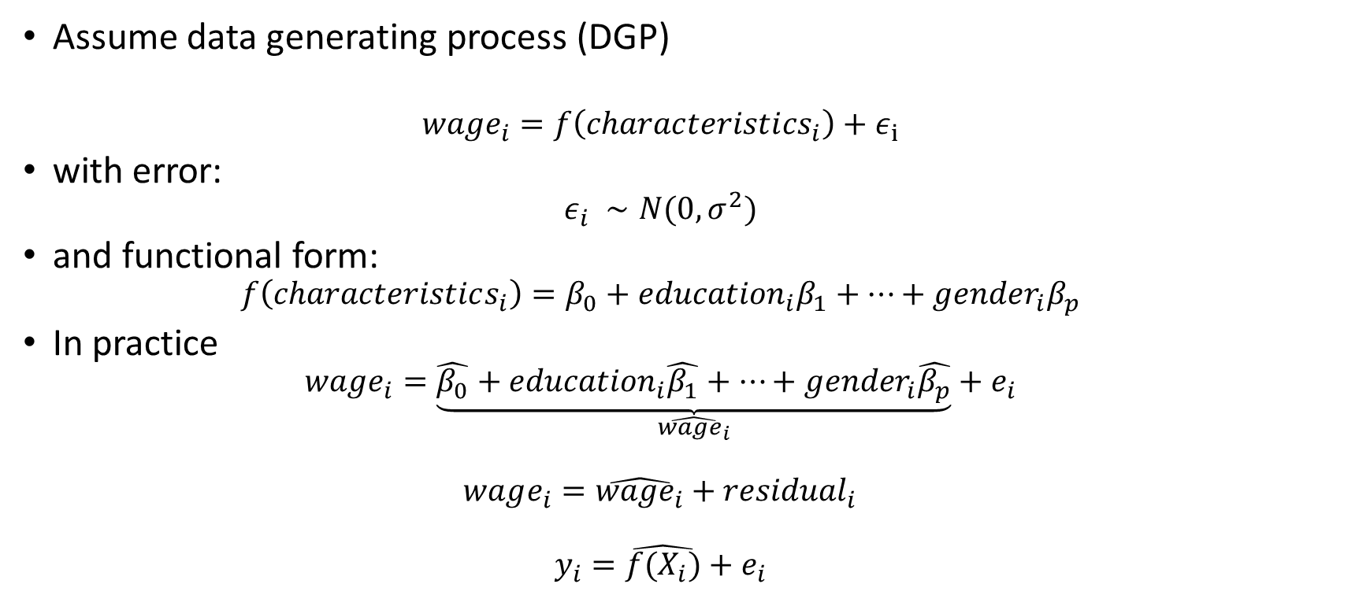
Theory vs. Practice
Assume data generating process (DGP)
$$wage_{i}=f\left(characteristi{cs}_{i}\right)+ε_{i}$$
with error:
$$ε_{i} ∼N(0,σ^{2})$$
and functional form:
$$f\left(characteristics_{i}\right)=β_{0}+{education}_{i}β_{1}+…+{gender}_{i}β_{p}$$
In practice
$$wage_{i}=\underset{\hat{wage_{i}}}{\underbrace{\hat{β_{0}}+{education}_{i}\hat{β_{1}}+…+{gender}_{i}\hat{β_{p}}}}+e_{i}$$
$$wage_{i}=\hat{wage_{i}}+{residual}_{i}$$
$$y_{i}=\hat{f(X_{i})}+e_{i}$$

Slide 13
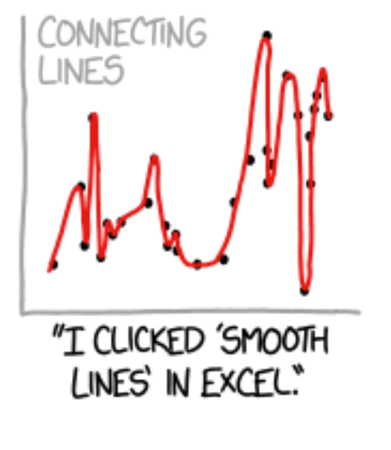
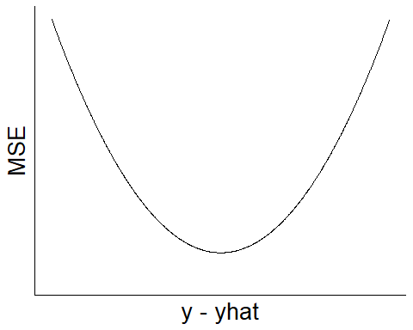
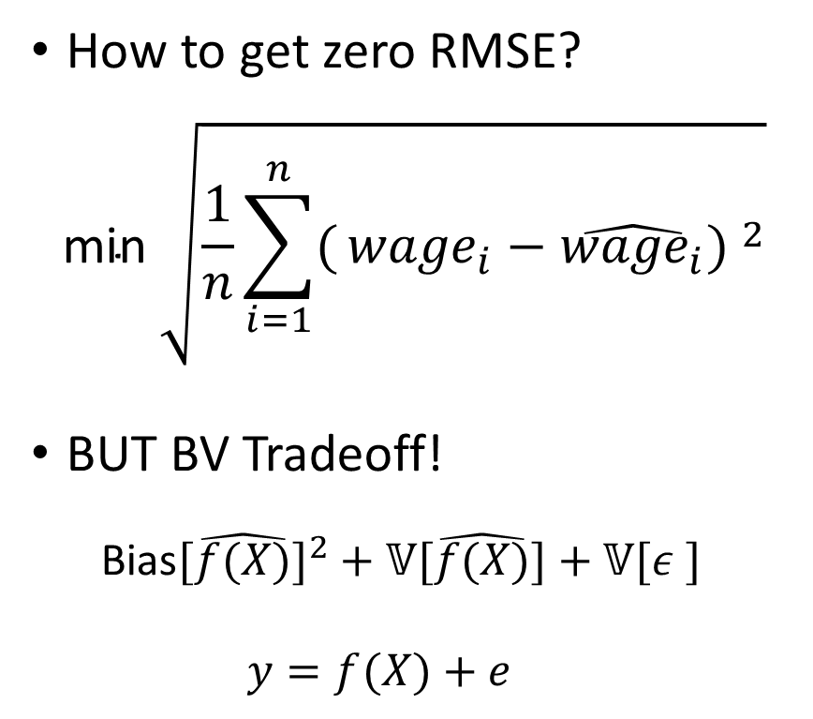
MSE Minimization
How to get zero RMSE?
$$\text{min} \sqrt{\frac{1}{n}\sum_{i=1}^{n}{(}{wage}_{i}−\hat{{wage}_{i}}) ^{2}}$$
BUT BV Tradeoff!
$$\text{Bias}[\hat{f(X)}]^{2}+𝕍[\hat{f(X)}]+𝕍[ε_{ }^{ }]$$
$$y=f(X)+e$$

Slide 14
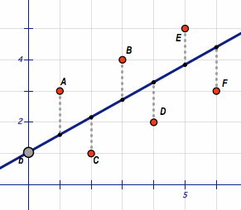
Regression Fitting Intuition
Source: https://en.wikipedia.org/wiki/File:Least_Squares.gif

Slide 15
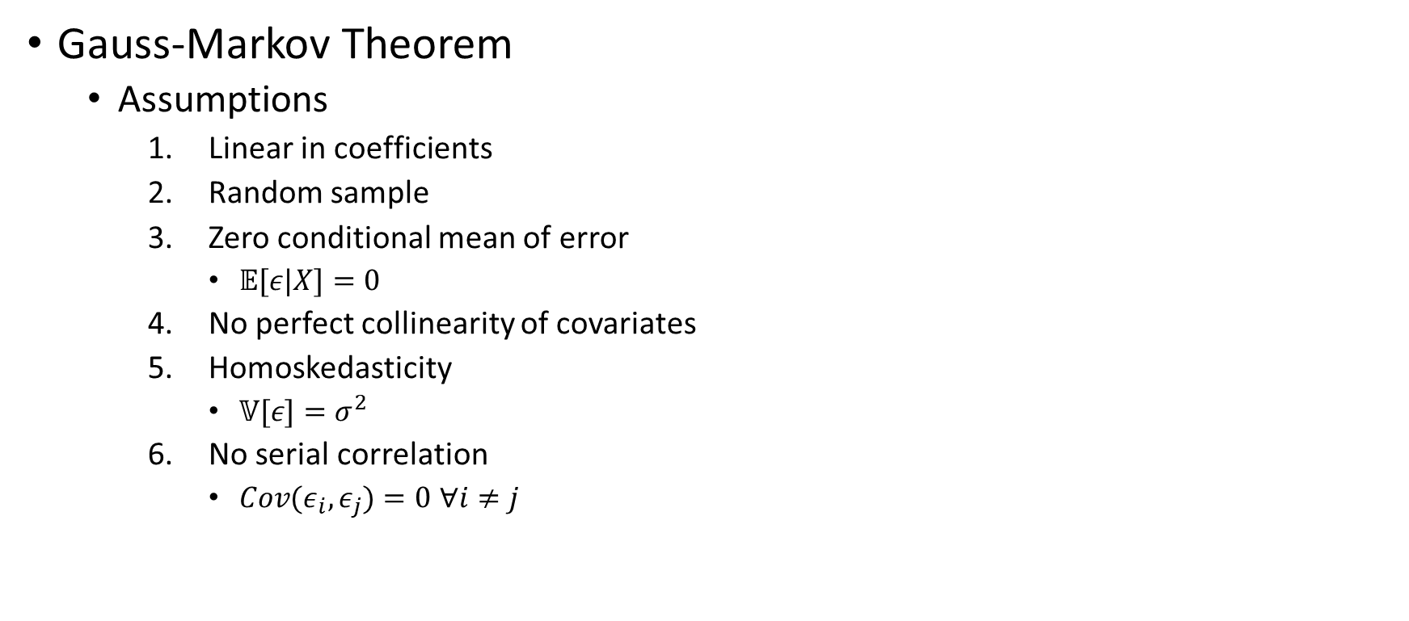
BLUE - Best Linear Unbiased Estimator
Gauss-Markov Theorem
Assumptions
Linear in coefficients
Random sample
Zero conditional mean of error
$𝔼[ε|X]=0$
No perfect collinearity of covariates
Homoskedasticity
$𝕍[ε]=σ^{2}$
No serial correlation
$Cov(ε_{i},ε_{j})=0$ $∀i≠j$

Slide 16
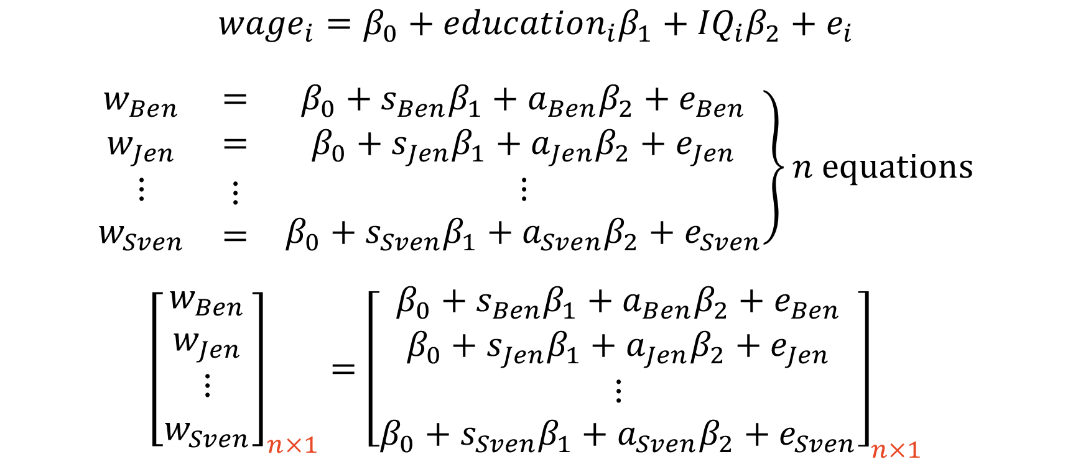
A Matrix Tangent – Systems of Equations
$${wage}_{i}=β_{0}+education_{i}β_{1}+{IQ}_{i}β_{2}+e_{i}$$
$$\left.\begin{matrix}w_{Ben} & = & β_{0}+s_{Ben}β_{1}+a_{Ben}β_{2}+e_{Ben} \\ w_{Jen} & = & β_{0}+s_{Jen}β_{1}+a_{Jen}β_{2}+e_{Jen} \\ \begin{aligned}⋮ \\ w_{Sven}\end{aligned} & \begin{aligned}⋮ \\ =\end{aligned} & \begin{aligned}⋮ \\ β_{0}+s_{Sven}β_{1}+a_{Sven}β_{2}+e_{Sven}\end{aligned}\end{matrix}\right\}n equations$$
$${\left[\begin{aligned}w_{Ben} \\ w_{Jen} \\ ⋮ \\ w_{Sven}\end{aligned}\right]}_{n×1}={\left[\begin{aligned}\begin{aligned}β_{0}+s_{Ben}β_{1}+a_{Ben}β_{2}+e_{Ben} \\ β_{0}+s_{Jen}β_{1}+a_{Jen}β_{2}+e_{Jen}\end{aligned} \\ ⋮ \\ β_{0}+s_{Sven}β_{1}+a_{Sven}β_{2}+e_{Sven}\end{aligned}\right]}_{n×1}$$

Slide 17
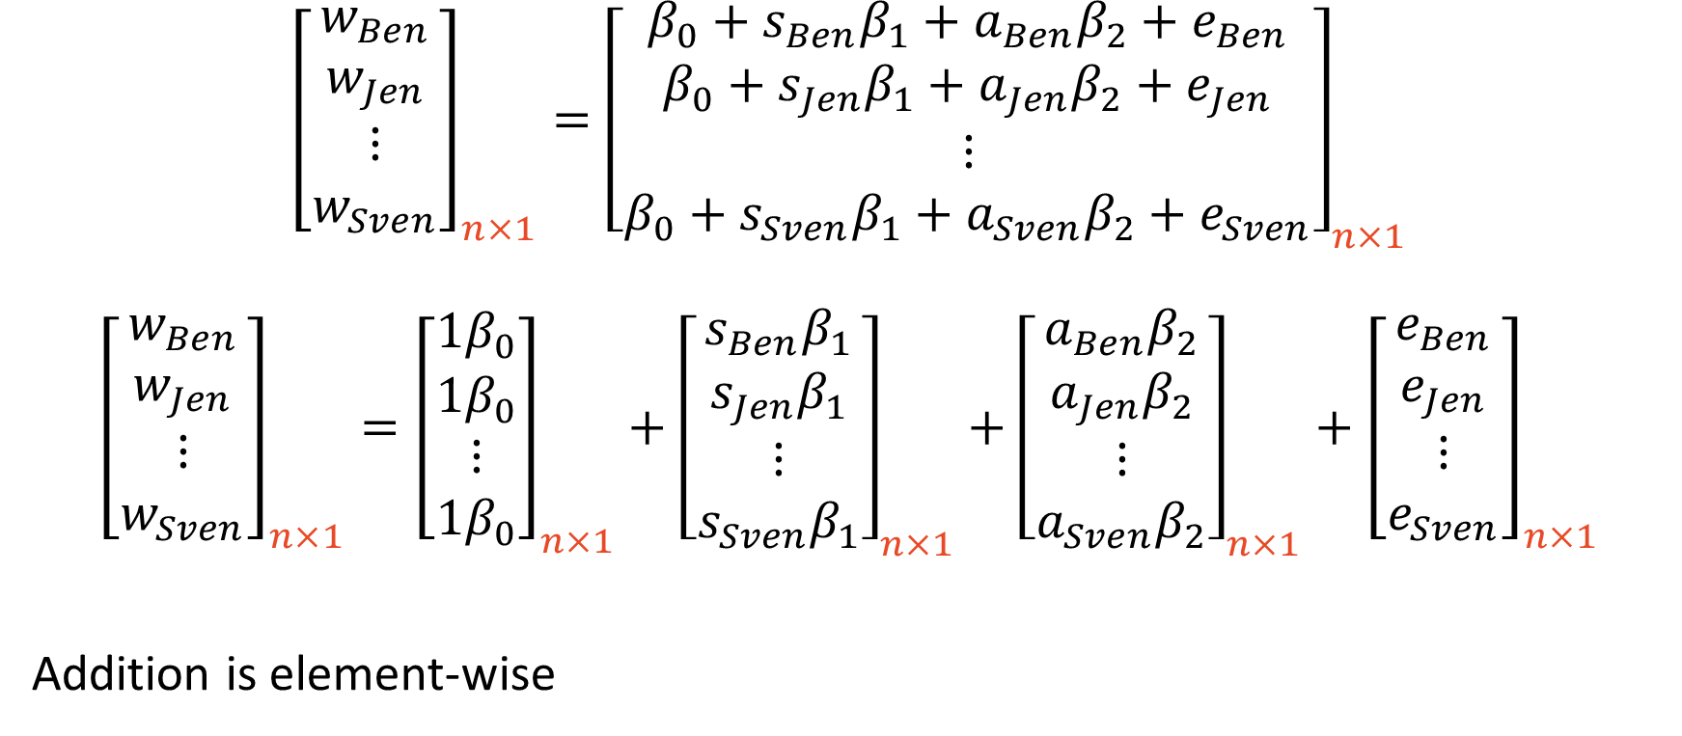
A Matrix Tangent – Vector (Matrix) Addition
$${\left[\begin{aligned}w_{Ben} \\ w_{Jen} \\ ⋮ \\ w_{Sven}\end{aligned}\right]}_{n×1}={\left[\begin{aligned}\begin{aligned}β_{0}+s_{Ben}β_{1}+a_{Ben}β_{2}+e_{Ben} \\ β_{0}+s_{Jen}β_{1}+a_{Jen}β_{2}+e_{Jen}\end{aligned} \\ ⋮ \\ β_{0}+s_{Sven}β_{1}+a_{Sven}β_{2}+e_{Sven}\end{aligned}\right]}_{n×1}$$
$${\left[\begin{aligned}w_{Ben} \\ w_{Jen} \\ ⋮ \\ w_{Sven}\end{aligned}\right]}_{n×1}={\left[\begin{aligned}1β_{0} \\ 1β_{0} \\ ⋮ \\ 1β_{0}\end{aligned}\right]}_{n×1}+{\left[\begin{aligned}s_{Ben}β_{1} \\ s_{Jen}β_{1} \\ ⋮ \\ s_{Sven}β_{1}\end{aligned}\right]}_{n×1}+{\left[\begin{aligned}a_{Ben}β_{2} \\ a_{Jen}β_{2} \\ ⋮ \\ a_{Sven}β_{2}\end{aligned}\right]}_{n×1}+{\left[\begin{aligned}e_{Ben} \\ e_{Jen} \\ ⋮ \\ e_{Sven}\end{aligned}\right]}_{n×1}$$
Addition is element-wise

Slide 18
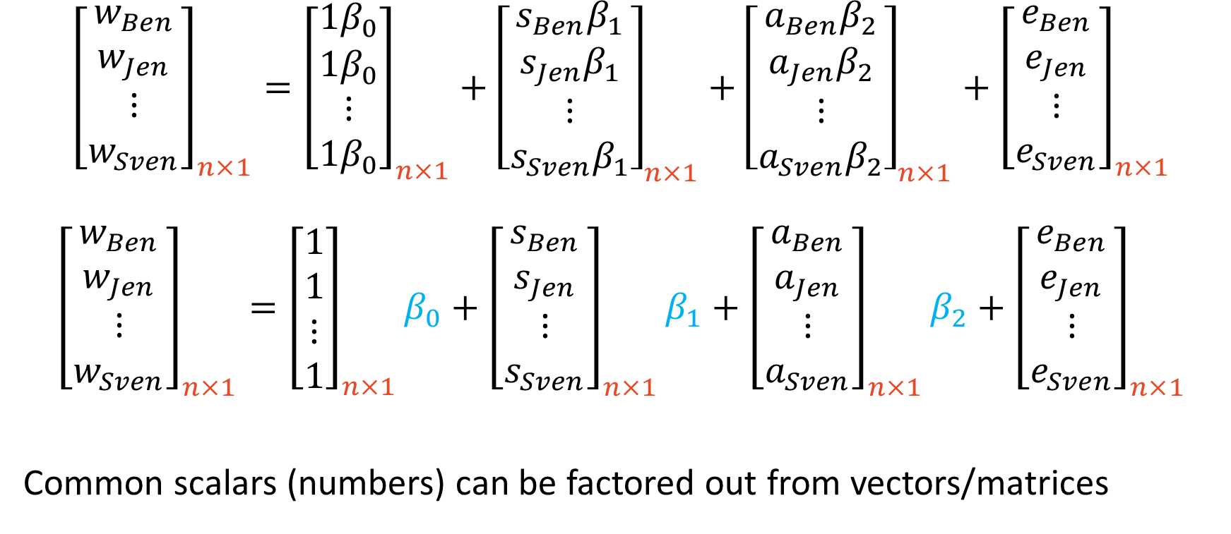
A Matrix Tangent – Scalar Factoring
$${\left[\begin{aligned}w_{Ben} \\ w_{Jen} \\ ⋮ \\ w_{Sven}\end{aligned}\right]}_{n×1}={\left[\begin{aligned}1β_{0} \\ 1β_{0} \\ ⋮ \\ 1β_{0}\end{aligned}\right]}_{n×1}+{\left[\begin{aligned}s_{Ben}β_{1} \\ s_{Jen}β_{1} \\ ⋮ \\ s_{Sven}β_{1}\end{aligned}\right]}_{n×1}+{\left[\begin{aligned}a_{Ben}β_{2} \\ a_{Jen}β_{2} \\ ⋮ \\ a_{Sven}β_{2}\end{aligned}\right]}_{n×1}+{\left[\begin{aligned}e_{Ben} \\ e_{Jen} \\ ⋮ \\ e_{Sven}\end{aligned}\right]}_{n×1}$$
$${\left[\begin{aligned}w_{Ben} \\ w_{Jen} \\ ⋮ \\ w_{Sven}\end{aligned}\right]}_{n×1}={\left[\begin{aligned}1 \\ 1 \\ ⋮ \\ 1\end{aligned}\right]}_{n×1}β_{0}+{\left[\begin{aligned}s_{Ben} \\ s_{Jen} \\ ⋮ \\ s_{Sven}\end{aligned}\right]}_{n×1}β_{1}+{\left[\begin{aligned}a_{Ben} \\ a_{Jen} \\ ⋮ \\ a_{Sven}\end{aligned}\right]}_{n×1}β_{2}+{\left[\begin{aligned}e_{Ben} \\ e_{Jen} \\ ⋮ \\ e_{Sven}\end{aligned}\right]}_{n×1}$$
Common scalars (numbers) can be factored out from vectors/matrices

Slide 19
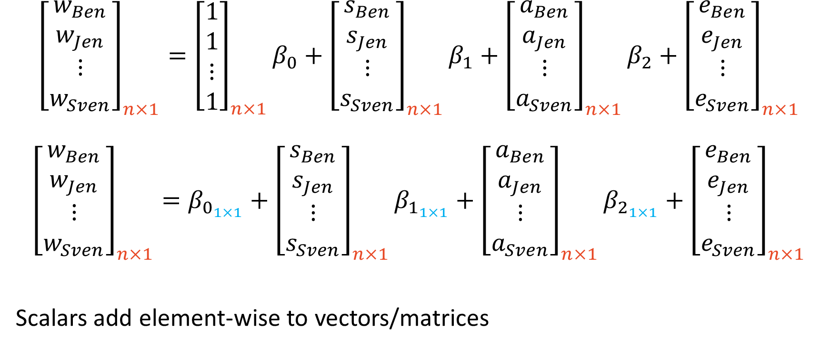
A Matrix Tangent – Scalar Addition and Multiplication
$${\left[\begin{aligned}w_{Ben} \\ w_{Jen} \\ ⋮ \\ w_{Sven}\end{aligned}\right]}_{n×1}={\left[\begin{aligned}1 \\ 1 \\ ⋮ \\ 1\end{aligned}\right]}_{n×1}β_{0}+{\left[\begin{aligned}s_{Ben} \\ s_{Jen} \\ ⋮ \\ s_{Sven}\end{aligned}\right]}_{n×1}β_{1}+{\left[\begin{aligned}a_{Ben} \\ a_{Jen} \\ ⋮ \\ a_{Sven}\end{aligned}\right]}_{n×1}β_{2}+{\left[\begin{aligned}e_{Ben} \\ e_{Jen} \\ ⋮ \\ e_{Sven}\end{aligned}\right]}_{n×1}$$
$${\left[\begin{aligned}w_{Ben} \\ w_{Jen} \\ ⋮ \\ w_{Sven}\end{aligned}\right]}_{n×1}=β_{0_{1×1}}+{\left[\begin{aligned}s_{Ben} \\ s_{Jen} \\ ⋮ \\ s_{Sven}\end{aligned}\right]}_{n×1}β_{1_{1×1}}+{\left[\begin{aligned}a_{Ben} \\ a_{Jen} \\ ⋮ \\ a_{Sven}\end{aligned}\right]}_{n×1}β_{2_{1×1}}+{\left[\begin{aligned}e_{Ben} \\ e_{Jen} \\ ⋮ \\ e_{Sven}\end{aligned}\right]}_{n×1}$$
Scalars add element-wise to vectors/matrices

Slide 20
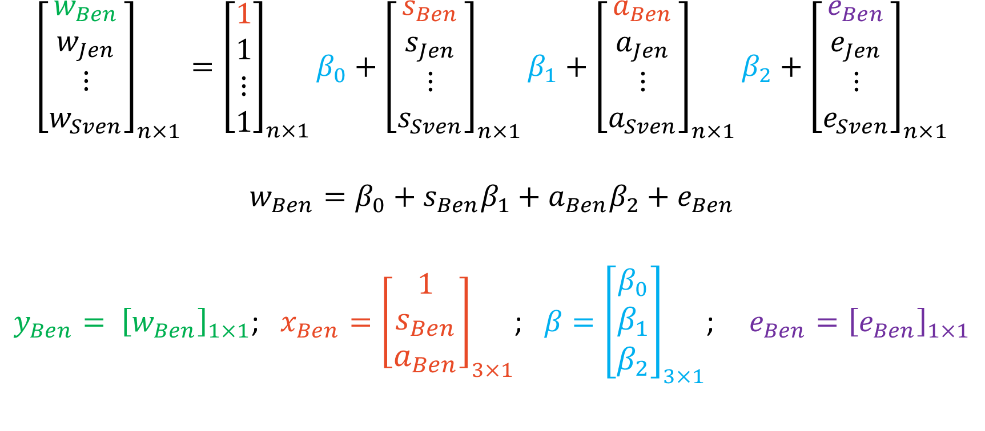
A Matrix Tangent – Vector Multiplication
$${\left[\begin{aligned}w_{Ben} \\ w_{Jen} \\ ⋮ \\ w_{Sven}\end{aligned}\right]}_{n×1}={\left[\begin{aligned}1 \\ 1 \\ ⋮ \\ 1\end{aligned}\right]}_{n×1}β_{0}+{\left[\begin{aligned}s_{Ben} \\ s_{Jen} \\ ⋮ \\ s_{Sven}\end{aligned}\right]}_{n×1}β_{1}+{\left[\begin{aligned}a_{Ben} \\ a_{Jen} \\ ⋮ \\ a_{Sven}\end{aligned}\right]}_{n×1}β_{2}+{\left[\begin{aligned}e_{Ben} \\ e_{Jen} \\ ⋮ \\ e_{Sven}\end{aligned}\right]}_{n×1}$$
$$w_{Ben}=β_{0}+s_{Ben}β_{1}+a_{Ben}β_{2}+e_{Ben}$$
$y_{Ben}= {\left[w_{Ben}\right]}_{1×1}$; $x_{Ben}={\left[\begin{aligned}1 \\ s_{Ben} \\ a_{Ben}\end{aligned}\right]}_{3×1}$; $β={\left[\begin{aligned}β_{0} \\ β_{1} \\ β_{2}\end{aligned}\right]}_{3×1}$; $e_{Ben}={\left[e_{Ben}\right]}_{1×1}$

Slide 21
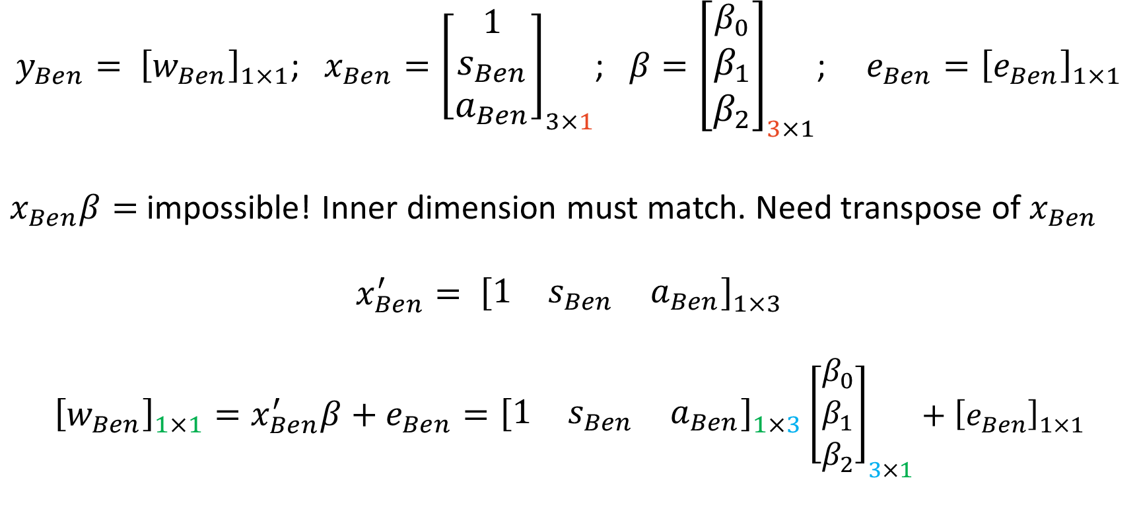
A Matrix Tangent – Vector Multiplication
$y_{Ben}= {\left[w_{Ben}\right]}_{1×1}$; $x_{Ben}={\left[\begin{aligned}1 \\ s_{Ben} \\ a_{Ben}\end{aligned}\right]}_{3×1}$; $β={\left[\begin{aligned}β_{0} \\ β_{1} \\ β_{2}\end{aligned}\right]}_{3×1}$; $e_{Ben}={\left[e_{Ben}\right]}_{1×1}$
$x_{Ben}β=$ impossible! Inner dimension must match. Need transpose of $x_{Ben}$
$$x_{Ben}^{′}= {\left[\begin{matrix}1 & s_{Ben} & a_{Ben}\end{matrix}\right]}_{1×3}$$
$${\left[w_{Ben}\right]}_{1×1}=x_{Ben}^{′}β+e_{Ben}={\left[\begin{matrix}1 & s_{Ben} & a_{Ben}\end{matrix}\right]}_{1×3}{\left[\begin{aligned}β_{0} \\ β_{1} \\ β_{2}\end{aligned}\right]}_{3×1}+{\left[e_{Ben}\right]}_{1×1}$$

Slide 22
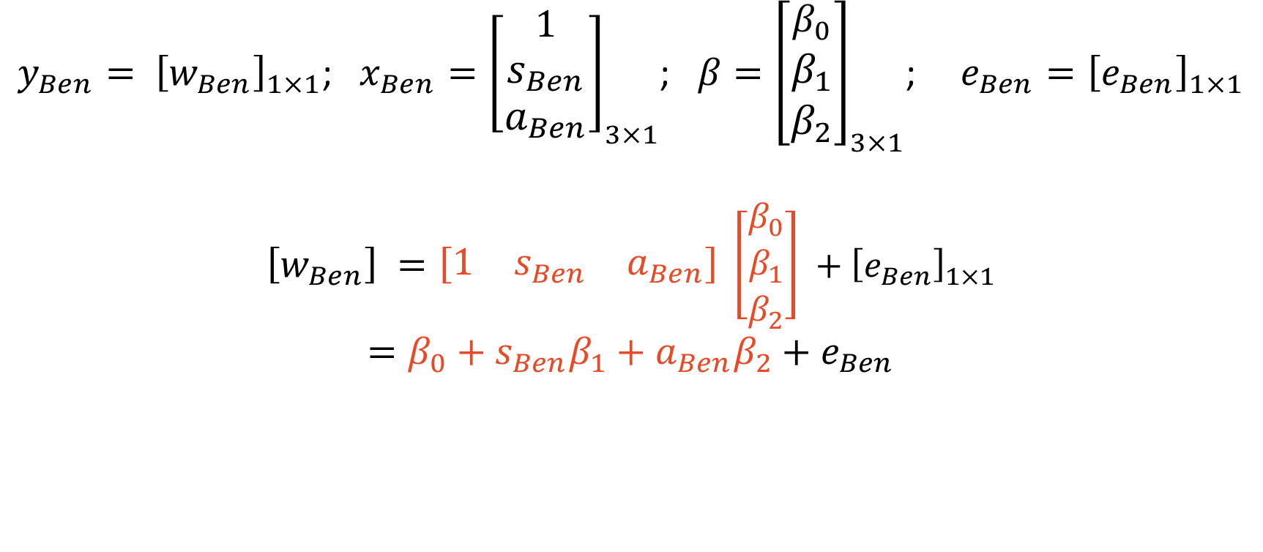
A Matrix Tangent – Vector Multiplication
$y_{Ben}= {\left[w_{Ben}\right]}_{1×1}$; $x_{Ben}={\left[\begin{aligned}1 \\ s_{Ben} \\ a_{Ben}\end{aligned}\right]}_{3×1}$; $β={\left[\begin{aligned}β_{0} \\ β_{1} \\ β_{2}\end{aligned}\right]}_{3×1}$; $e_{Ben}={\left[e_{Ben}\right]}_{1×1}$
$${\left[w_{Ben}\right]}_{ }={\left[\begin{matrix}1 & s_{Ben} & a_{Ben}\end{matrix}\right]}_{ }{\left[\begin{aligned}β_{0} \\ β_{1} \\ β_{2}\end{aligned}\right]}_{ }+{\left[e_{Ben}\right]}_{1×1}$$
$$=β_{0}+s_{Ben}β_{1}+a_{Ben}β_{2}+e_{Ben}$$

Slide 23
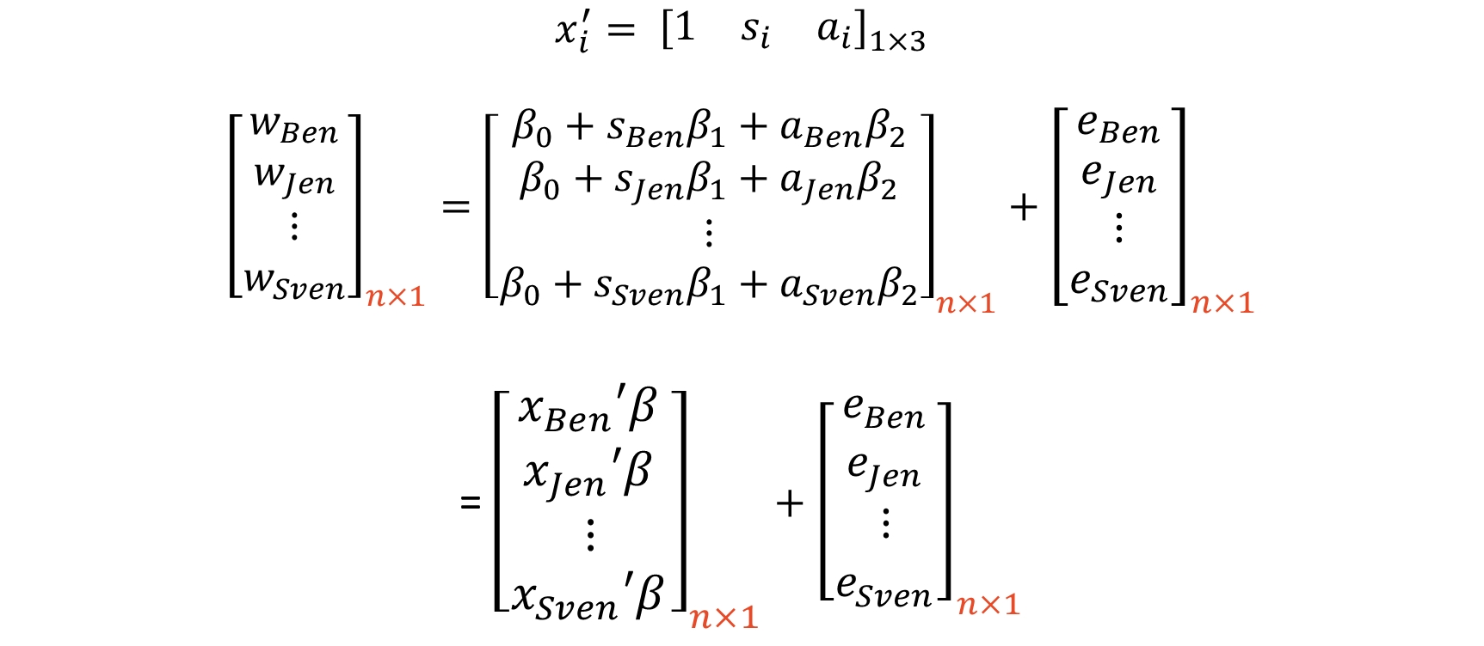
A Matrix Tangent – Matrix Multiplication
$$x_{i}^{′}= {\left[\begin{matrix}1 & s_{i} & a_{i}\end{matrix}\right]}_{1×3}$$
$${\left[\begin{aligned}w_{Ben} \\ w_{Jen} \\ ⋮ \\ w_{Sven}\end{aligned}\right]}_{n×1}={\left[\begin{aligned}\begin{aligned}β_{0}+s_{Ben}β_{1}+a_{Ben}β_{2} \\ β_{0}+s_{Jen}β_{1}+a_{Jen}β_{2}\end{aligned} \\ ⋮ \\ β_{0}+s_{Sven}β_{1}+a_{Sven}β_{2}\end{aligned}\right]}_{n×1}+{\left[\begin{aligned}e_{Ben} \\ e_{Jen} \\ ⋮ \\ e_{Sven}\end{aligned}\right]}_{n×1}$$
= ${\left[\begin{aligned}\begin{aligned}x_{Ben}′β_{ } \\ x_{Jen}′β_{ }\end{aligned} \\ ⋮ \\ x_{Sven}′β_{ }\end{aligned}\right]}_{n×1}+{\left[\begin{aligned}e_{Ben} \\ e_{Jen} \\ ⋮ \\ e_{Sven}\end{aligned}\right]}_{n×1}$

Slide 24
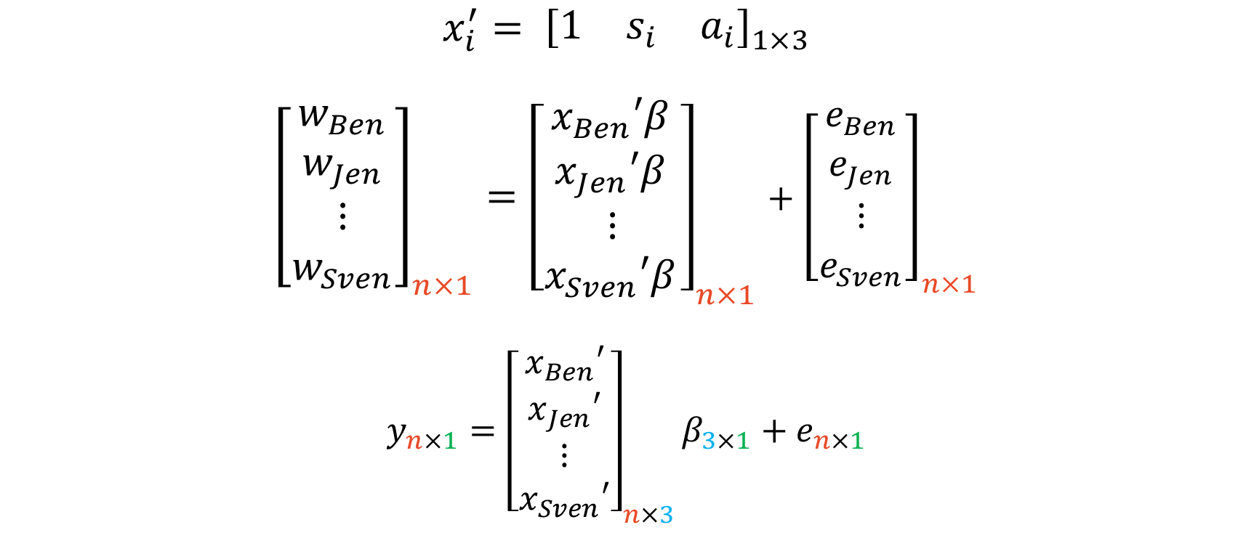
A Matrix Tangent – Matrix Multiplication
$$x_{i}^{′}= {\left[\begin{matrix}1 & s_{i} & a_{i}\end{matrix}\right]}_{1×3}$$
$${\left[\begin{aligned}w_{Ben} \\ w_{Jen} \\ ⋮ \\ w_{Sven}\end{aligned}\right]}_{n×1}={\left[\begin{aligned}\begin{aligned}x_{Ben}′β_{ } \\ x_{Jen}′β_{ }\end{aligned} \\ ⋮ \\ x_{Sven}′β_{ }\end{aligned}\right]}_{n×1}+{\left[\begin{aligned}e_{Ben} \\ e_{Jen} \\ ⋮ \\ e_{Sven}\end{aligned}\right]}_{n×1}$$
$y_{n×1}={\left[\begin{aligned}\begin{aligned}x_{Ben}′ \\ x_{Jen}′\end{aligned} \\ ⋮ \\ x_{Sven}′\end{aligned}\right]}_{n×3}β_{3×1}+e_{n×1}$

Slide 25
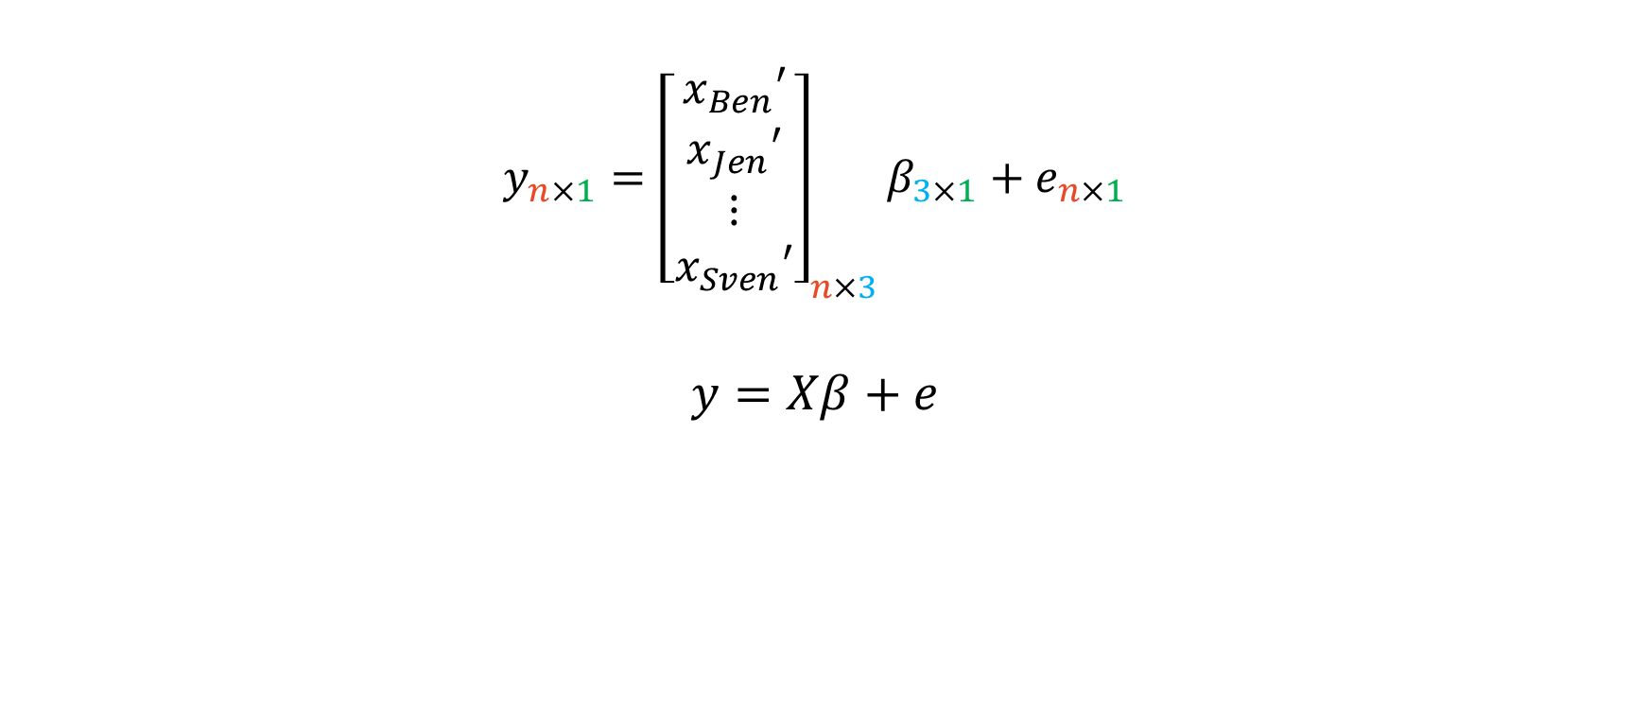
A Matrix Tangent – Matrix Multiplication
$y_{n×1}={\left[\begin{aligned}\begin{aligned}x_{Ben}′ \\ x_{Jen}′\end{aligned} \\ ⋮ \\ x_{Sven}′\end{aligned}\right]}_{n×3}β_{3×1}+e_{n×1}$
$$y=Xβ+e$$

Slide 26
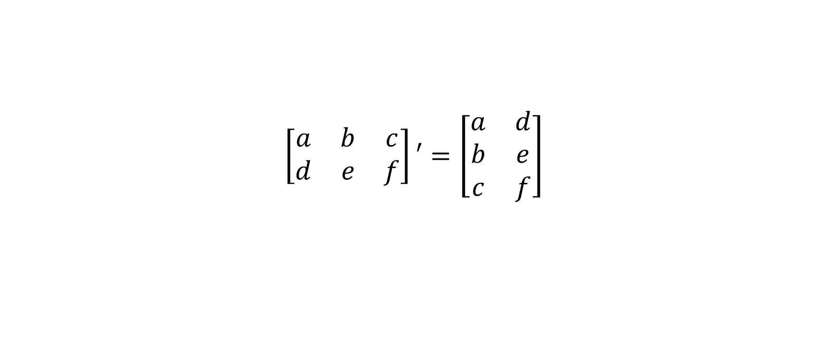
Quick! Matrix Transposes!
$$\left[\begin{matrix}a & b & c \\ d & e & f\end{matrix}\right]′=\left[\begin{matrix}a & d \\ b & e \\ c & f\end{matrix}\right]$$

Slide 27
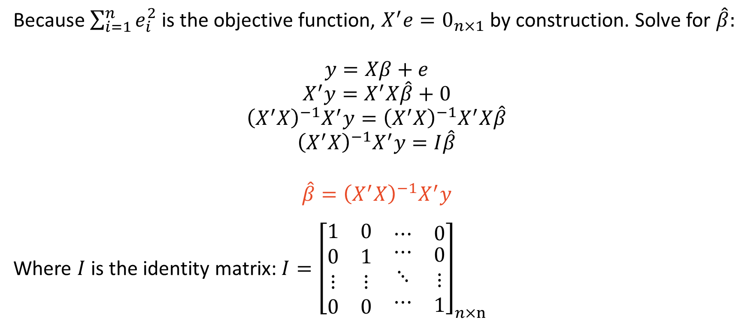
A Matrix Tangent – $\hat{β}$
Because $\sum_{i=1}^{n}{e_{i}^{2}}$ is the objective function, $X^{′}e=0_{n×1}$ by construction. Solve for $\hat{β}:$
$$y=Xβ+e$$
$$X^{′}y=X^{′}X\hat{β}+0$$
$${\left(X^{′}X\right)}^{−1}X^{′}y={\left(X^{′}X\right)}^{−1}X^{′}X\hat{β}$$
$${\left(X^{′}X\right)}^{−1}X^{′}y=I\hat{β}$$
$$\hat{β}={\left(X^{′}X\right)}^{−1}X^{′}y$$
Where $I$ is the identity matrix: $I={\left[\begin{matrix}\begin{matrix}\begin{aligned}1 \\ 0 \\ ⋮ \\ 0\end{aligned} & \begin{aligned}0 \\ 1 \\ ⋮ \\ 0\end{aligned}\end{matrix} & \begin{aligned}\begin{matrix}⋯ & 0\end{matrix} \\ \begin{matrix}\begin{aligned}⋯ \\ ⋱ \\ ⋯\end{aligned} & \begin{aligned}0 \\ ⋮ \\ 1\end{aligned}\end{matrix}\end{aligned}\end{matrix}\right]}_{n×n}$

Slide 28
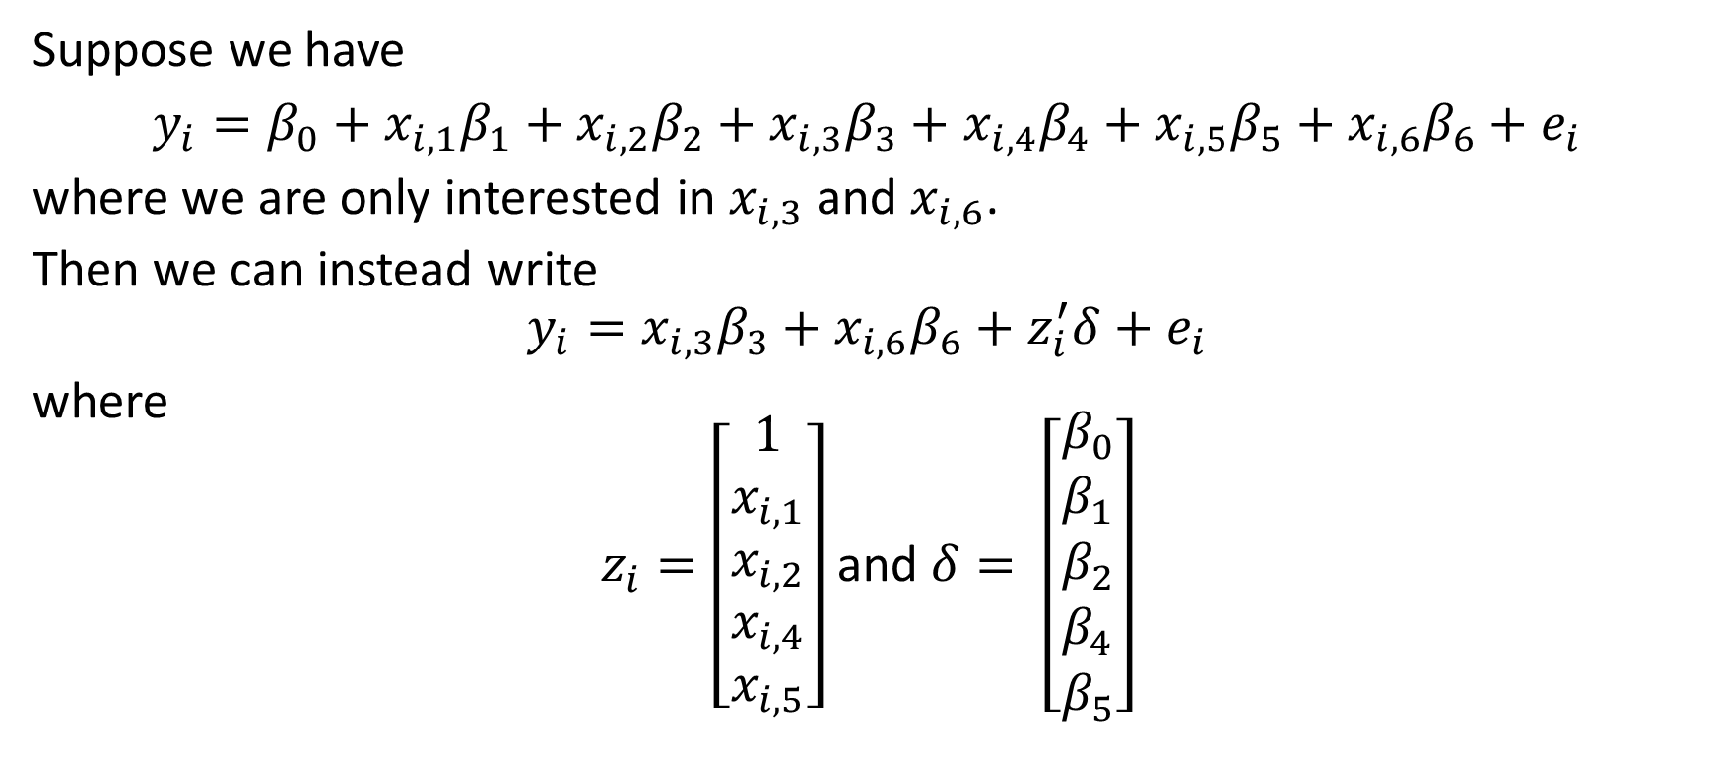
A Matrix Tangent – Notation for Consolidation
Suppose we have
$y_{i}=β_{0}+x_{i,1}β_{1}+$ $x_{i,2}β_{2}+$ $x_{i,3}β_{3}+$ $x_{i,4}β_{4}+$ $x_{i,5}β_{5}+$ $x_{i,6}β_{6}+e_{i}$
where we are only interested in $x_{i,3}$ and $x_{i,6}$.
Then we can instead write
$$y_{i}=x_{i,3}β_{3}+x_{i,6}β_{6}+z_{i}^{′}δ+e_{i}$$
where
$z_{i}=\left[\begin{aligned}1 \\ x_{i,1} \\ x_{i,2} \\ x_{i,4} \\ x_{i,5}\end{aligned}\right]$ and $δ= \left[\begin{aligned}β_{0} \\ β_{1} \\ β_{2} \\ β_{4} \\ β_{5}\end{aligned}\right]$

Slide 29
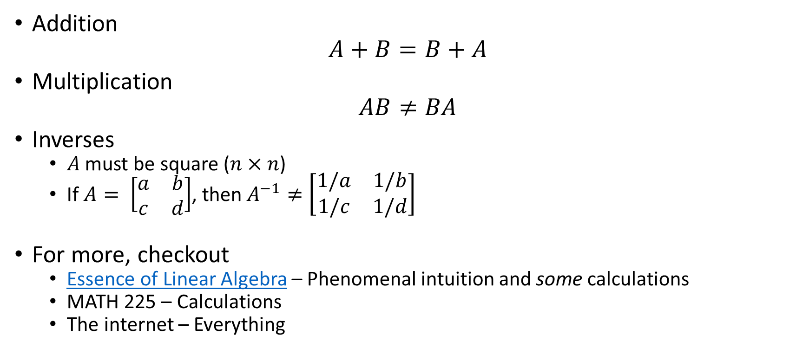
More Matrix Notes
Addition
$$A+B=B+A$$
Multiplication
$$AB≠BA$$
Inverses
$A$ must be square ($n×n$)
If $A= \left[\begin{matrix}a & b \\ c & d\end{matrix}\right]$, then $A^{−1}≠\left[\begin{matrix}1/a & 1/b \\ 1/c & 1/d\end{matrix}\right]$
For more, checkout
Essence of Linear Algebra – Phenomenal intuition and some calculations
MATH 225 – Calculations
The internet – Everything

Slide 30
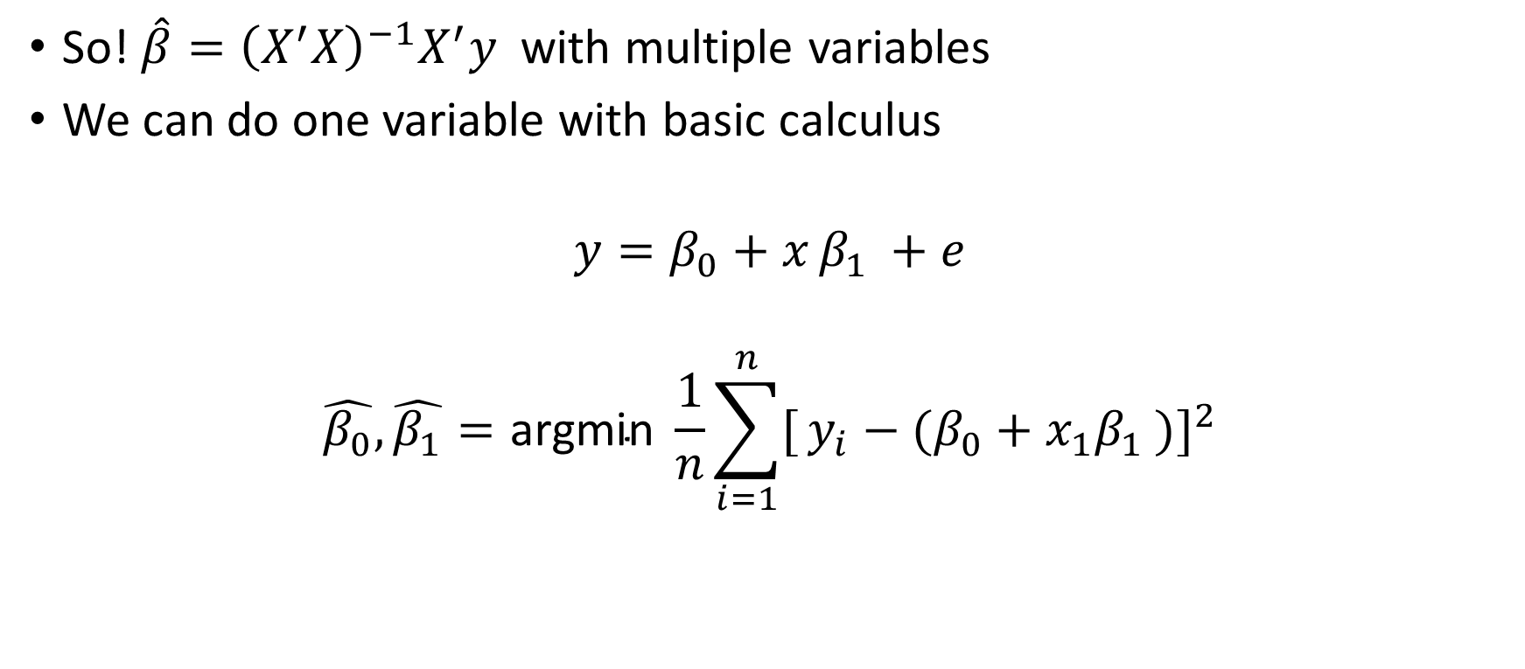
Coefficient Estimation: SLR
So! $\hat{β}={\left(X^{′}X\right)}^{−1}X^{′}y$ with multiple variables
We can do one variable with basic calculus
$$y=β_{0}+x_{ }{β_{1}}_{ }+e$$
$$\hat{β_{0}},\hat{β_{1}}=\text{argmin} \frac{1}{n}\sum_{i=1}^{n}{[}y_{i}−(β_{0}+x_{1}{β_{1}}_{ })]^{2}$$

Slide 31
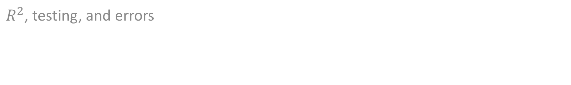
Important Technical Details
$R^{2}$, testing, and errors

Slide 32
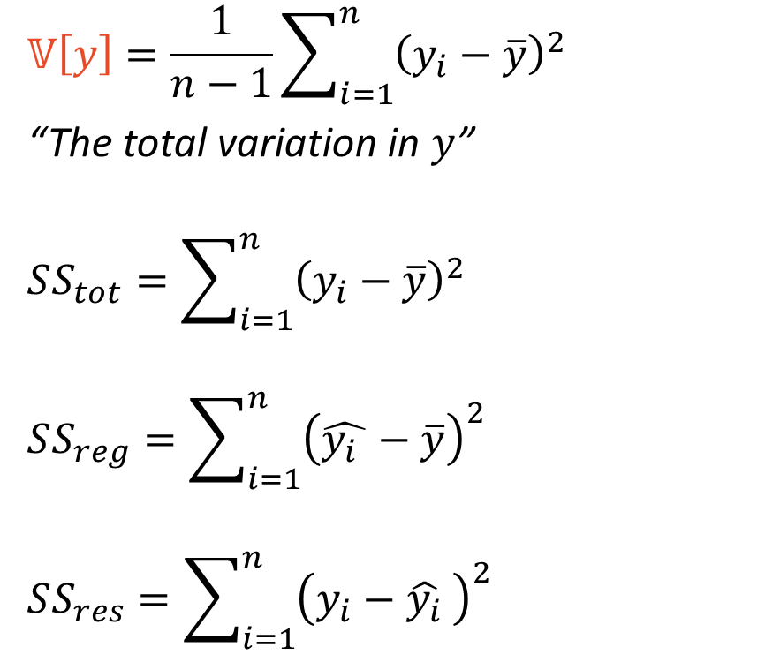
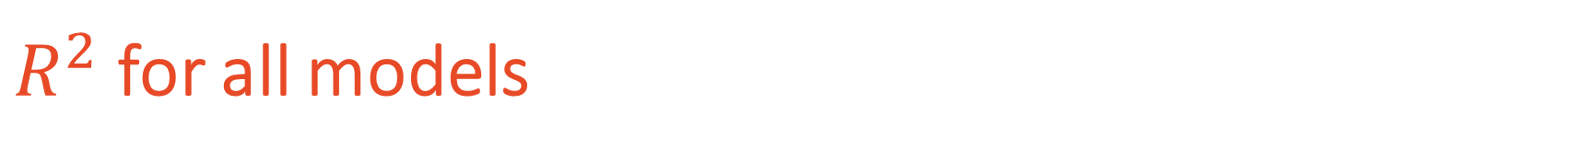
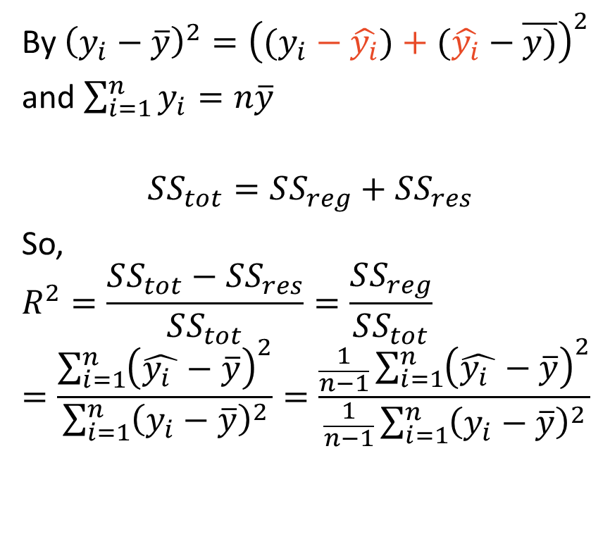
$R^{2}$ for all models
$$𝕍\left[y\right]=\frac{1}{n−1}\sum_{i=1}^{n}{{\left(y_{i}−\overline{y}\right)}^{2}}$$
“The total variation in $y$”
$$SS_{tot}=\sum_{i=1}^{n}{{\left(y_{i}−\overline{y}\right)}^{2}}$$
$$SS_{reg}=\sum_{i=1}^{n}{{\left(\hat{{y_{i}}_{ }}−\overline{y}\right)}^{2}}$$
$$SS_{res}=\sum_{i=1}^{n}{{\left(y_{i}−{\hat{y_{i}}}_{ }\right)}^{2}}$$
By ${\left(y_{i}−\overline{y}\right)}^{2}={\left((y_{i}−\hat{y_{i}})+(\hat{y_{i}}−\overline{y)}\right)}^{2}$
and $\sum_{i=1}^{n}{y_{i}=n\overline{y}}$
$$SS_{tot}=SS_{reg}+SS_{res}$$
So,
$$R^{2}=\frac{SS_{tot}−SS_{res}}{SS_{tot}}=\frac{SS_{reg}}{SS_{tot}}$$
$$=\frac{\sum_{i=1}^{n}{{\left(\hat{{y_{i}}_{ }}−\overline{y}\right)}^{2}}}{\sum_{i=1}^{n}{{\left(y_{i}−\overline{y}\right)}^{2}}}=\frac{\frac{1}{n−1}\sum_{i=1}^{n}{{\left(\hat{{y_{i}}_{ }}−\overline{y}\right)}^{2}}}{\frac{1}{n−1}\sum_{i=1}^{n}{{\left(y_{i}−\overline{y}\right)}^{2}}}$$

Slide 33
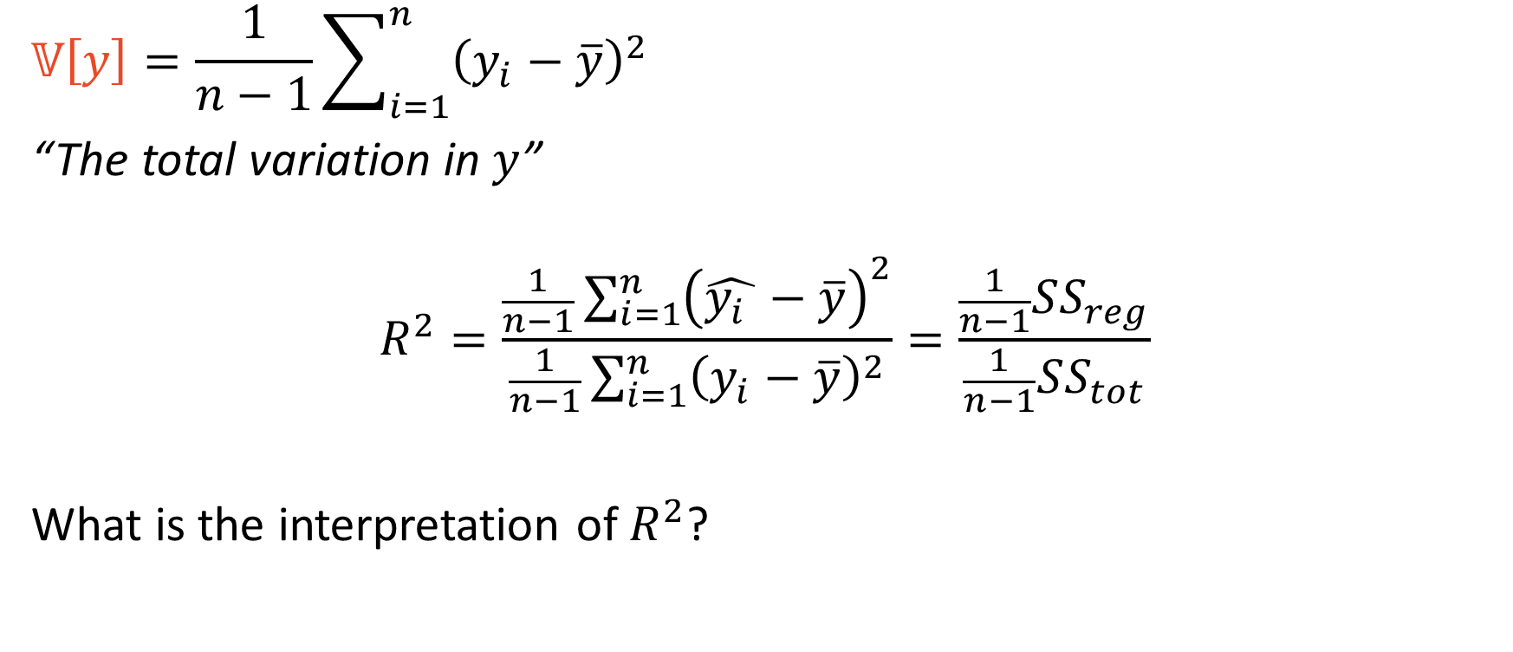
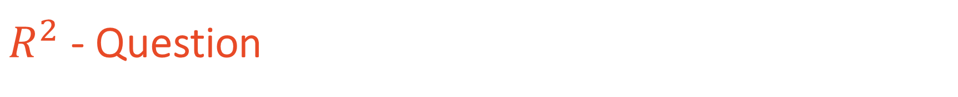
$R^{2}$ - Question
$$𝕍\left[y\right]=\frac{1}{n−1}\sum_{i=1}^{n}{{\left(y_{i}−\overline{y}\right)}^{2}}$$
“The total variation in $y$”
$$R^{2}=\frac{\frac{1}{n−1}\sum_{i=1}^{n}{{\left(\hat{{y_{i}}_{ }}−\overline{y}\right)}^{2}}}{\frac{1}{n−1}\sum_{i=1}^{n}{{\left(y_{i}−\overline{y}\right)}^{2}}}=\frac{\frac{1}{n−1}SS_{reg}}{\frac{1}{n−1}SS_{tot}}$$
What is the interpretation of $R^{2}$?

Slide 34
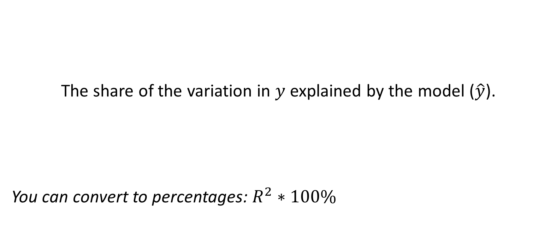
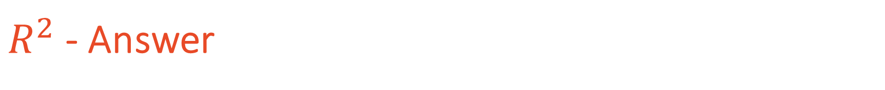
$R^{2}$ - Answer
The share of the variation in $y$ explained by the model ($\hat{y}$).
You can convert to percentages: $R^{2}∗100\%$

Slide 35
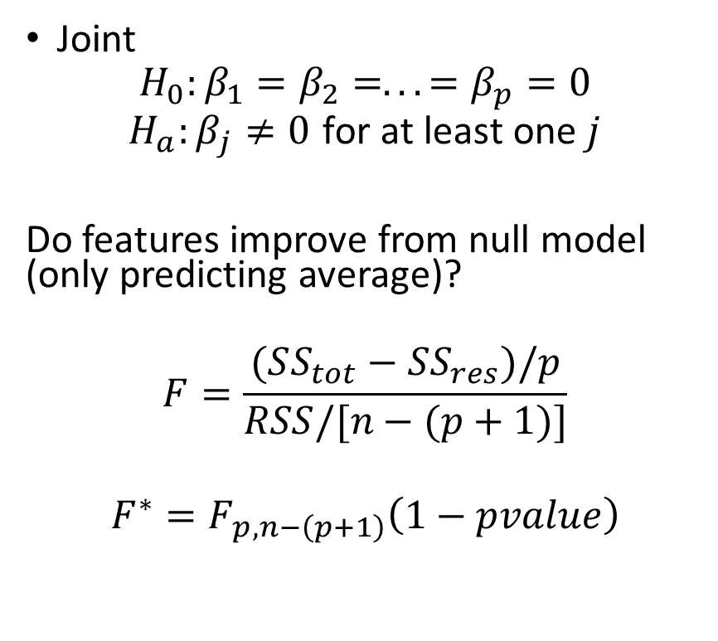
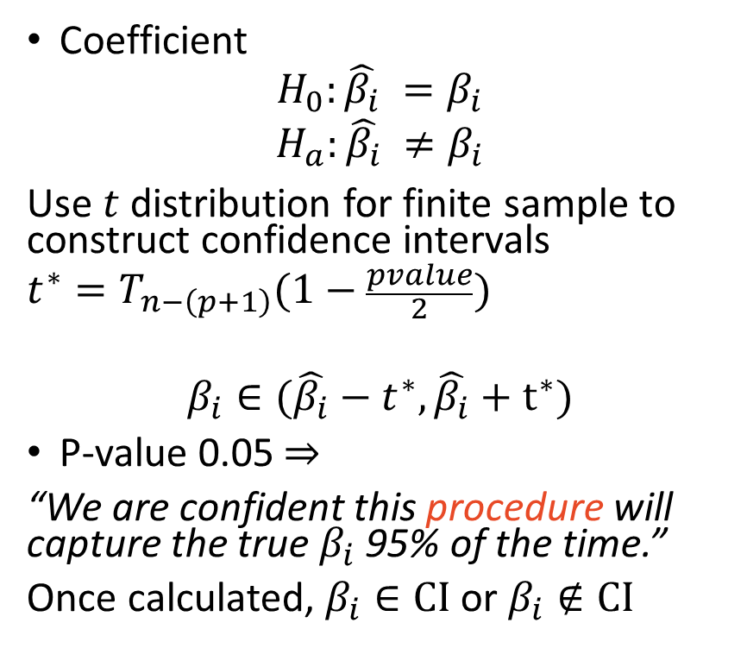
Hypothesis Testing
Coefficient
$$H_{0}:{\hat{β_{i}}}_{ }=β_{i}$$
$$H_{a}:{\hat{β_{i}}}_{ }≠β_{i}$$
Use $t$ distribution for finite sample to construct confidence intervals
$$t^{∗}=T_{n−\left(p+1\right)}(1−\frac{pvalue}{2})$$
$$β_{i}∈(\hat{β_{i}}−t^{∗},\hat{β_{i}}+t^{∗})$$
P-value 0.05 $⇒$
“We are confident this procedure will capture the true $β_{i}$ 95% of the time.”
Once calculated, $β_{i}∈CI$ or $β_{i}∉CI$
Joint
$$H_{0}:β_{1}=β_{2}=...=β_{p}=0$$
$$H_{a}:β_{j}≠0 \text{for} \text{at} \text{least} \text{one} j$$
Do features improve from null model (only predicting average)?
$$F=\frac{(SS_{tot}−SS_{res})/p}{RSS/[n−(p+1)]}$$
$$F^{∗}=F_{p,n−\left(p+1\right)}\left(1−pvalue\right)$$

Slide 36
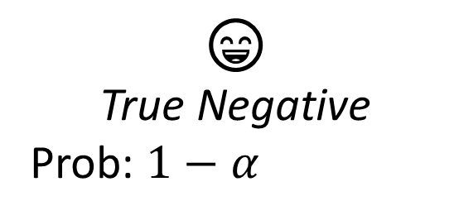
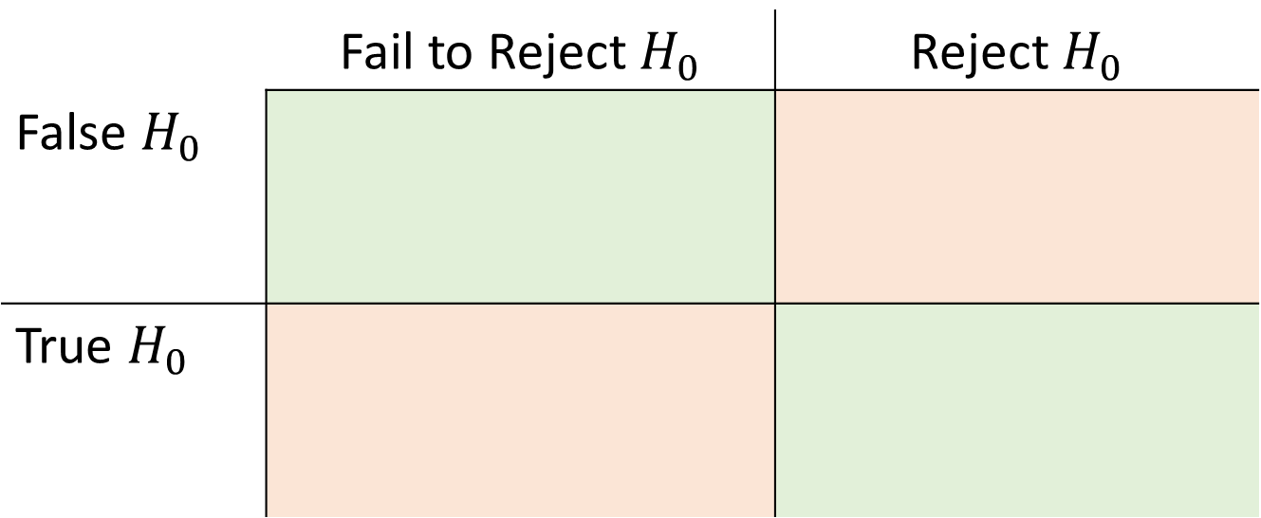

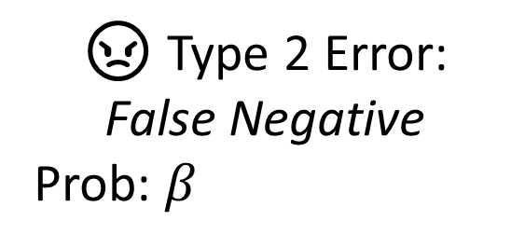
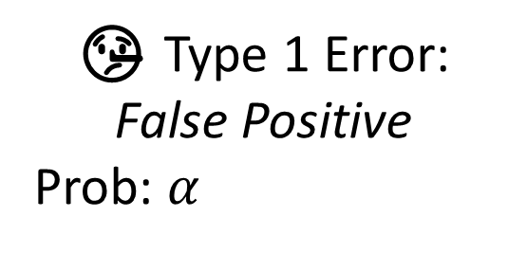
Types of Error
 | Fail to Reject $H_{0}$ | Reject $H_{0}$
False $H_{0}$
True $H_{0}$
😄
True Negative
Prob: $1−α$
🤥 Type 1 Error: False Positive
Prob: $α$
😠 Type 2 Error:
False Negative
Prob: $β_{ }$
💪 Power!
True Positive
Prob: $1−β$

Slide 37
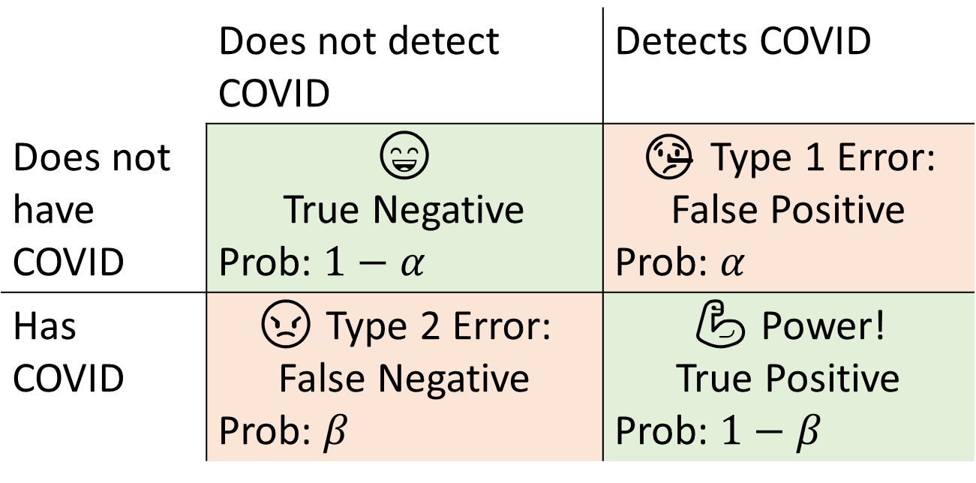
Types of Error - COVID
 | Does not detect COVID | Detects COVID
Does not have COVID | 😄 True Negative Prob: $1−α$ | 🤥 Type 1 Error: False Positive Prob: $α$
Has COVID | 😠 Type 2 Error: False Negative Prob: $β_{ }$ | 💪 Power! True Positive Prob: $1−β$

Slide 38
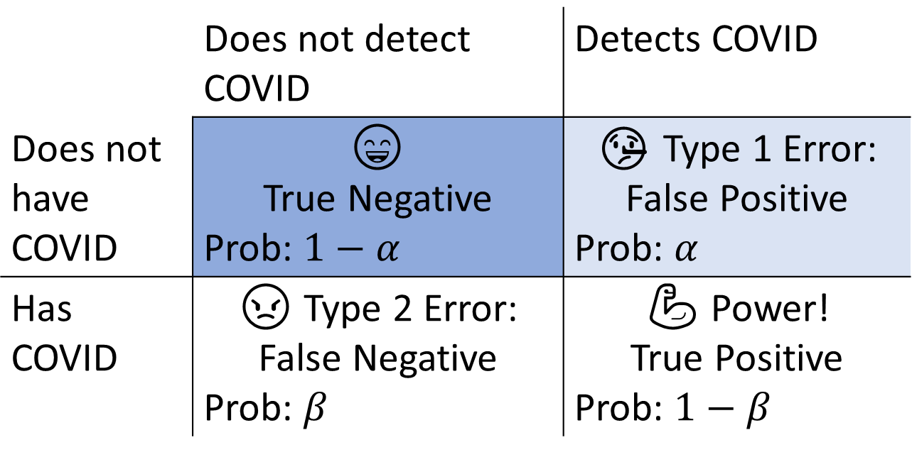
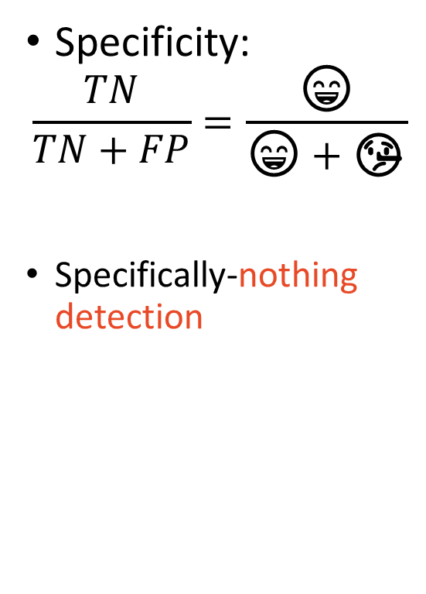
Diagnostics – Specificity
 | Does not detect COVID | Detects COVID
Does not have COVID | 😄 True Negative Prob: $1−α$ | 🤥 Type 1 Error: False Positive Prob: $α$
Has COVID | 😠 Type 2 Error: False Negative Prob: $β_{ }$ | 💪 Power! True Positive Prob: $1−β$
Specificity:
$$\frac{TN}{TN+FP}=\frac{\text{😄}}{\text{😄}+\text{🤥}}$$
Specifically-nothing detection

Slide 39
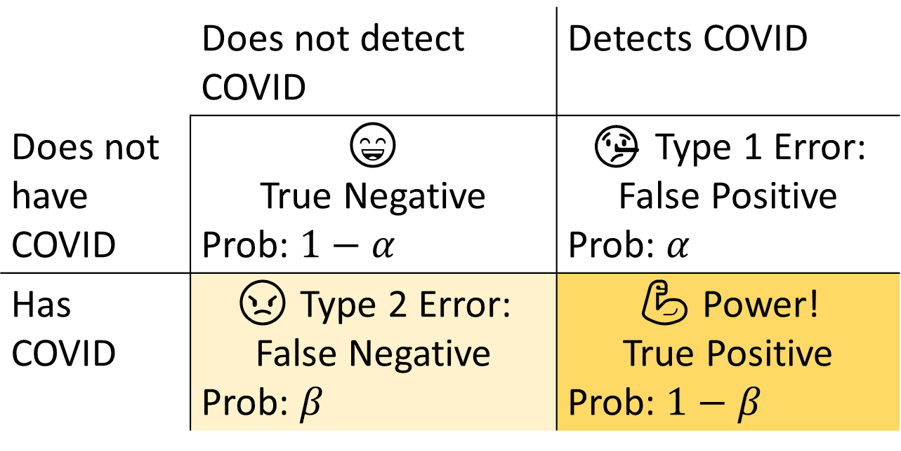
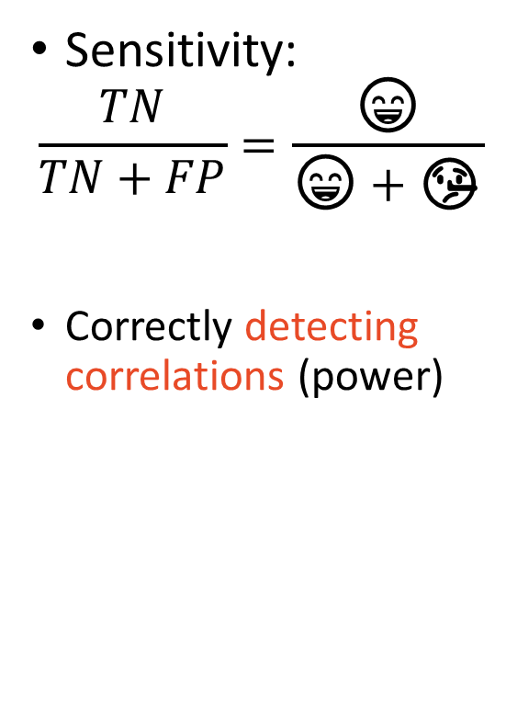
Diagnostics – Sensitivity
 | Does not detect COVID | Detects COVID
Does not have COVID | 😄 True Negative Prob: $1−α$ | 🤥 Type 1 Error: False Positive Prob: $α$
Has COVID | 😠 Type 2 Error: False Negative Prob: $β_{ }$ | 💪 Power! True Positive Prob: $1−β$
Sensitivity:
$$\frac{TN}{TN+FP}=\frac{\text{😄}}{\text{😄}+\text{🤥}}$$
Correctly detecting correlations (power)

Slide 40
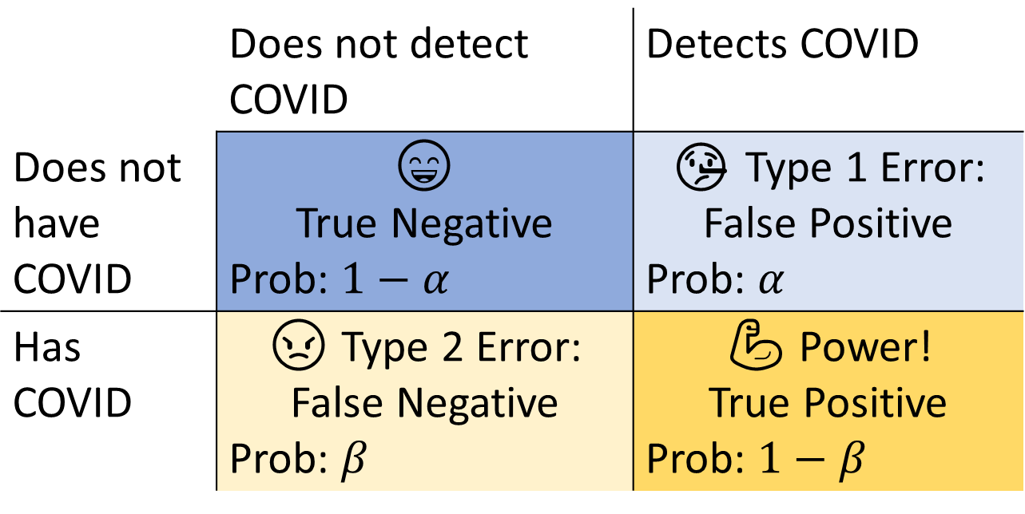
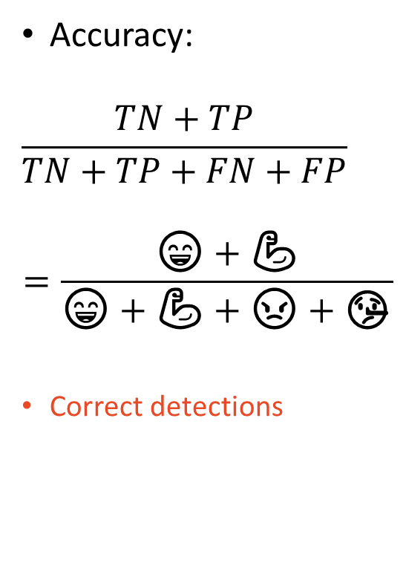
Diagnostics – Accuracy
 | Does not detect COVID | Detects COVID
Does not have COVID | 😄 True Negative Prob: $1−α$ | 🤥 Type 1 Error: False Positive Prob: $α$
Has COVID | 😠 Type 2 Error: False Negative Prob: $β_{ }$ | 💪 Power! True Positive Prob: $1−β$
Accuracy:
$$\frac{TN+TP}{TN+TP+FN+FP}$$
$$=\frac{\text{😄}+\text{💪}}{\text{😄}+\text{💪}+\text{😠}+\text{🤥}}$$
Correct detections

Slide 41
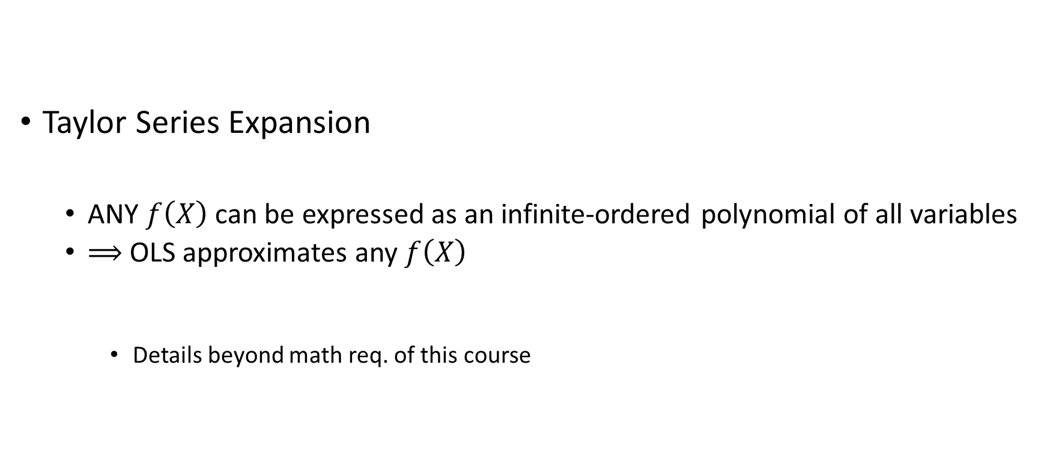
Importance of OLS
Taylor Series Expansion
ANY $f\left(X\right)$ can be expressed as an infinite-ordered polynomial of all variables
$⟹$ OLS approximates any $f\left(X\right)$
Details beyond math req. of this course

Slide 42
OLS Interpretation
Linearity

Slide 43
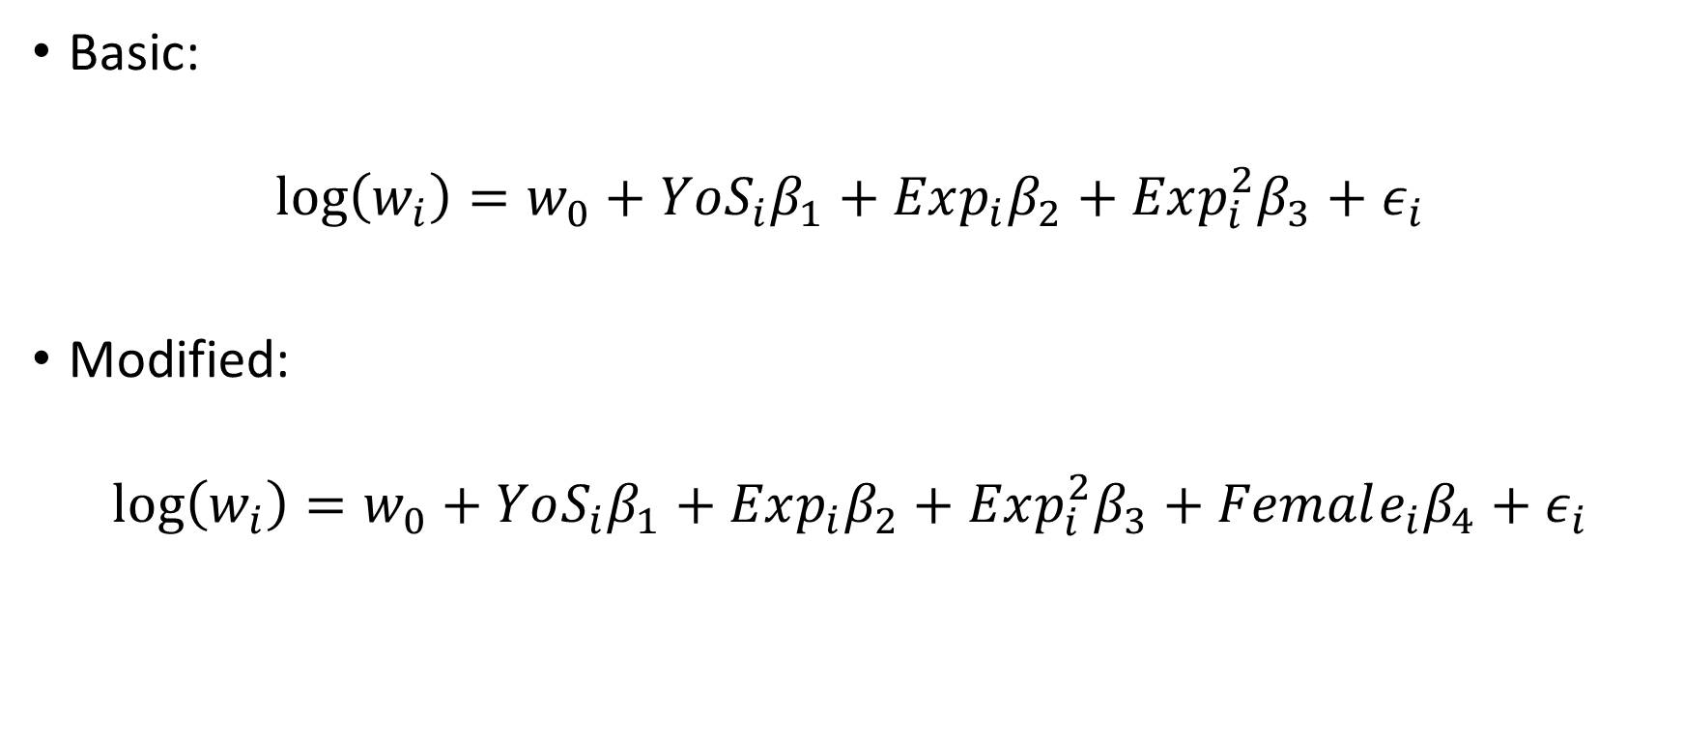
Mincer Equation
Basic:
$$\log\left(w_{i}\right)=w_{0}+YoS_{i}β_{1}+Exp_{i}β_{2}+Exp_{i}^{2}β_{3}+ε_{i}$$
Modified:
$$\log\left(w_{i}\right)=w_{0}+YoS_{i}β_{1}+Exp_{i}β_{2}+Exp_{i}^{2}β_{3}+Female_{i}β_{4}+ε_{i}$$

Slide 44
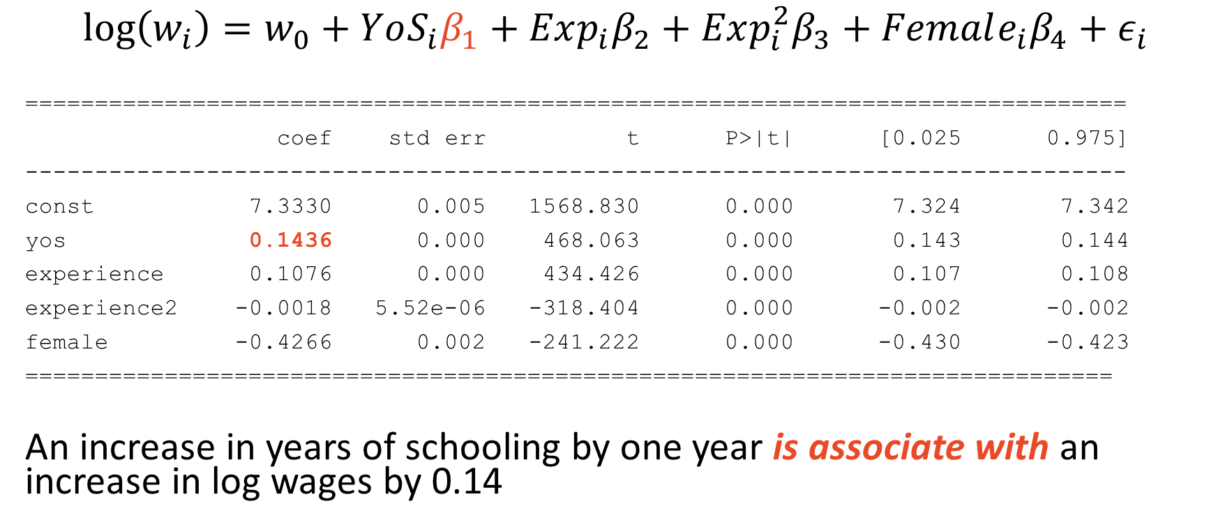
Interpretation – Years of Schooling (ACS 2016)
$$\log\left(w_{i}\right)=w_{0}+YoS_{i}β_{1}+Exp_{i}β_{2}+Exp_{i}^{2}β_{3}+Female_{i}β_{4}+ε_{i}$$
===============================================================================
coef std err t P>|t| [0.025 0.975]
-------------------------------------------------------------------------------
const 7.3330 0.005 1568.830 0.000 7.324 7.342
yos 0.1436 0.000 468.063 0.000 0.143 0.144
experience 0.1076 0.000 434.426 0.000 0.107 0.108
experience2 -0.0018 5.52e-06 -318.404 0.000 -0.002 -0.002
female -0.4266 0.002 -241.222 0.000 -0.430 -0.423
==============================================================================
An increase in years of schooling by one year is associate with an increase in log wages by 0.14

Slide 45

Interpretation
$$\log\left(w_{i}\right)=w_{0}+YoS_{i}β_{1}+Exp_{i}β_{2}+Exp_{i}^{2}β_{3}+Female_{i}β_{4}+ε_{i}$$
Note that $β_{1}=\frac{∂\log\left(w_{i}\right)}{∂YoS_{i}}$
Here, $\frac{∂\log\left(w_{i}\right)}{∂Exp_{i}}=β_{2}+2Exp_{i}β_{3}$
Hey, what is $\frac{∂y_{i}}{∂x_{i}}$ called in statistics/math?
Marginal effect (not causal effect!!!)

Slide 46

Interpretation – Years of Experience
$$\log\left(w_{i}\right)=w_{0}+YoS_{i}β_{1}+Exp_{i}β_{2}+Exp_{i}^{2}β_{3}+Female_{i}β_{4}+ε_{i}$$
===============================================================================
coef std err t P>|t| [0.025 0.975]
-------------------------------------------------------------------------------
const 7.3330 0.005 1568.830 0.000 7.324 7.342
yos 0.1436 0.000 468.063 0.000 0.143 0.144
experience 0.1076 0.000 434.426 0.000 0.107 0.108
experience2 -0.0018 5.52e-06 -318.404 0.000 -0.002 -0.002
female -0.4266 0.002 -241.222 0.000 -0.430 -0.423
==============================================================================
$$\frac{∂\log\left(w_{i}\right)}{∂Exp_{i}}=β_{2}+2Exp_{i}β_{3}=0.1076−2\left(0.0018\right)Exp_{i}$$

Slide 47


Interpretation – Years of Experience
$$\frac{∂\log\left(w_{i}\right)}{∂Exp_{i}}=β_{2}+2Exp_{i}β_{3}=0.1076−2\left(0.0018\right)Exp_{i}$$
“An increase in years of experience
by one year at the mean experience
level of 22 years is associated with
an increase in log wages by 0.03.”

Slide 48

Interpretation – Female
$$\log\left(w_{i}\right)=w_{0}+YoS_{i}β_{1}+Exp_{i}β_{2}+Exp_{i}^{2}β_{3}+Female_{i}β_{4}+ε_{i}$$
===============================================================================
coef std err t P>|t| [0.025 0.975]
-------------------------------------------------------------------------------
const 7.3330 0.005 1568.830 0.000 7.324 7.342
yos 0.1436 0.000 468.063 0.000 0.143 0.144
experience 0.1076 0.000 434.426 0.000 0.107 0.108
experience2 -0.0018 5.52e-06 -318.404 0.000 -0.002 -0.002
female -0.4266 0.002 -241.222 0.000 -0.430 -0.423
==============================================================================
$β_{4}$ is the “activated” when $i$ is female
It is “deactivated” when $i$ is not female

Slide 49

Interpretation – Female
$$\log\left(w_{i}\right)=w_{0}+YoS_{i}β_{1}+Exp_{i}β_{2}+Exp_{i}^{2}β_{3}+Female_{i}β_{4}+ε_{i}$$
===============================================================================
coef std err t P>|t| [0.025 0.975]
-------------------------------------------------------------------------------
const 7.3330 0.005 1568.830 0.000 7.324 7.342
yos 0.1436 0.000 468.063 0.000 0.143 0.144
experience 0.1076 0.000 434.426 0.000 0.107 0.108
experience2 -0.0018 5.52e-06 -318.404 0.000 -0.002 -0.002
female -0.4266 0.002 -241.222 0.000 -0.430 -0.423
==============================================================================
$w_{0}$ is the average log wage when $YoS_{i}=Exp_{i}=Female_{i}=0$
$w_{0}$ is the average log wage of males without education or experience

Slide 50

Interpretation – Female
$$\log\left(w_{i}\right)=w_{0}+YoS_{i}β_{1}+Exp_{i}β_{2}+Exp_{i}^{2}β_{3}+Female_{i}β_{4}+ε_{i}$$
===============================================================================
coef std err t P>|t| [0.025 0.975]
-------------------------------------------------------------------------------
const 7.3330 0.005 1568.830 0.000 7.324 7.342
yos 0.1436 0.000 468.063 0.000 0.143 0.144
experience 0.1076 0.000 434.426 0.000 0.107 0.108
experience2 -0.0018 5.52e-06 -318.404 0.000 -0.002 -0.002
female -0.4266 0.002 -241.222 0.000 -0.430 -0.423
==============================================================================
$β_{4}$: Being female is associated with a decrease in log wages of 0.43 with respect to non-females (males).

Slide 51

Interpreting log Variables
$$\log\left(w_{i}\right)=w_{0}+YoS_{i}β_{1}+Exp_{i}β_{2}+Exp_{i}^{2}β_{3}+Female_{i}β_{4}+ε_{i}$$
$$\%Δ=\frac{New−Old}{Old}$$
$$f\left(x\right)=log\left(x\right)$$
$⟹$ $\frac{df(x)}{dx}=\frac{1}{x}$
$⟹$ $df \left(x\right)=\frac{dx}{x}=\%Δ$

Slide 52

Interpreting log Variables
$$\log\left(w_{i}\right)=w_{0}+YoS_{i}β_{1}+Exp_{i}β_{2}+Exp_{i}^{2}β_{3}+Female_{i}β_{4}+ε_{i}$$
So for $β_{4}=−0.43$…
Being female is associated with a decrease in wages by 43%!
Notes
This is not an apples-to-apples comparison
Not same industry, same occupation, same firm, etc.
Should it matter?

Slide 53

Elasticities – More econometric love for regression
Cobb-Douglas Production Function
(Data: Manufacturing Industry Database on FP Data Sources.docx)
$$Y =e^{α+ε}L^{β_{1}}K^{β_{2}}$$
$$log(Y)=α+log(L)β_{1}+\text{log}(K)β_{2}+ε$$
$\frac{∂log\left(Y\right)}{∂log⁡(L)}=β_{1}$ is the marginal productivity of labor (MPL)
$β_{1}+β_{2}<1⇒$ decreasing returns to scale
$β_{1}+β_{2}=1⇒$ constant
$β_{1}+β_{2}>1⇒$ increasing

Slide 54
Model Comparison
Which is best?

Slide 55
Question: Is this good model performance?
Test RMSE = 2.65

Slide 56

Answer
I don’t know
Depends on scale of $y$
Multiply $y$ by 10 produces test RMSE of 26.5
Need to establish a baseline
The Null Model: $y_{i}=β_{0}+ε_{i}$
Test RMSE: 2.90
$$\%Δ =\frac{new−old}{old}∗100\%⇒\frac{2.65−2.90}{2.90}∗100\%≈−8.73\%$$
What is a good reduction?
It depends on the application (the data)
Rule of thumb: 10%

Slide 57
Next Time…
Apply these fundamentals in Python!
statsmodels
Probably best package for econometrics in Python
No reading assignment!

